Slide 1
Welcome To
Purchase College!
Greta Silva-Taraska:
Assistant Director of
Student Financial Services (SFS)

Slide 2
Agenda/Topics
What is Financial Aid?
  Federal Aid
    Federal Loans
  State Aid
Financial Aid Plan (also known as Award Letter or Financial Aid Package)
  Ebills
  Payment Plan options
Refunds
Tips & Q&A

Slide 3
Applying for Federal Aid
Completing the Free Application for Federal Student Aid (FAFSA®) is the first step toward getting federal aid for college.
How to apply: www.fafsa.gov
  Must be completed on an annual basis
Uses 2 year old income information
FAFSA Overview:
Completing your FAFSA Form

Slide 4
New York State Aid
(*For NYS residents only*)
In order to receive Financial Aid from the State of New York you must complete a separate application: www.ny.hesc.gov
New York State aid includes grants and scholarships:
Tuition Assistance Program (TAP) grant
SUNY Tuition Credit grant
Excelsior Scholarship:
  The Excelsior Scholarship Program requires you to complete the FAFSA & TAP application. the Excelsior Scholarship has its own application, including an Excelsior contract.
DREAM Act
  For non-documented students.
  *Each of these grants have their own application and their own set of rules and regulations that must be followed.*

Slide 5
Federal Direct Loans
Federal Direct Student Loans:
Subsidized Direct Loan- Fixed interest loan, Interest is paid by the government while the student is in school. Eligibility is based off the FAFSA application
Unsubsidized Direct Loan- Fixed interest loan that immediately accrues once disbursed.
Federal Direct Parent PLUS Loan: Credit Based Loan offered to parent(s). This loan is unsubsidized with a fixed interest rate

Slide 6
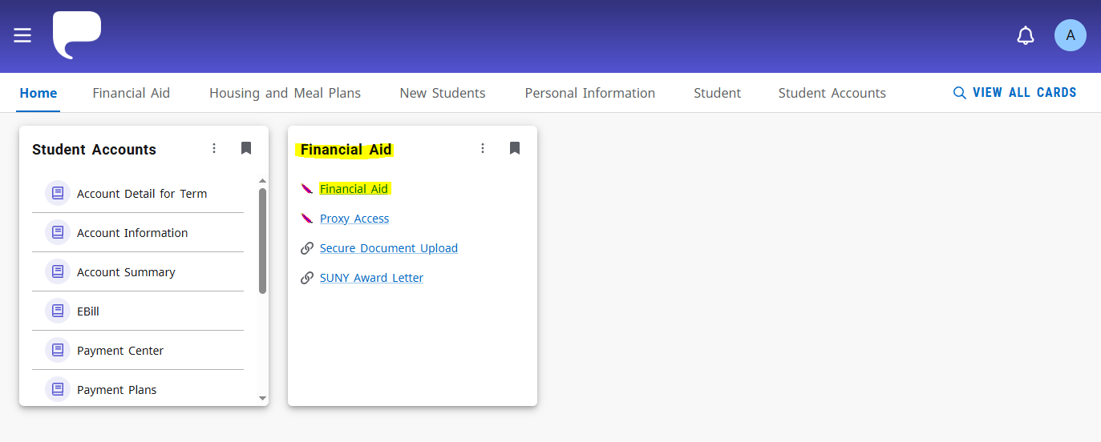
MyHeliotrope
Also known as the Student Portal. It’s important to monitor and know your way around your MyHeliotrope.
All student information will always be updated on your MyHeliotrope

Slide 7
PROXY/Authorized User (FERPA)
If you want your parent to have account or billing access, you MUST set up Poxy access and Authorized user access
  Proxy Access • Office of the Registrar • Purchase College

Slide 8
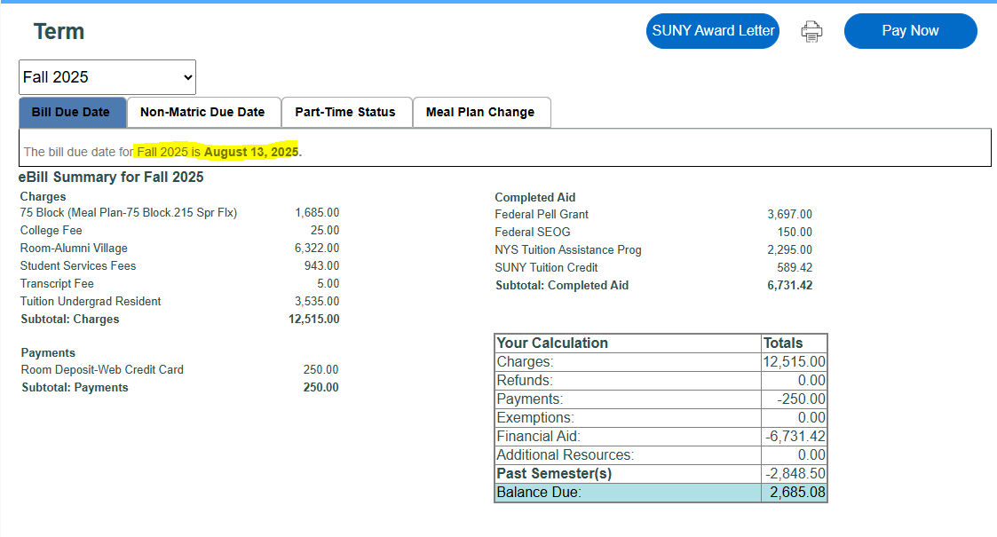
eBills
Student with a refund. (there was an overpayment on the Financial Aid)
Not all Student will receive a refund
All Students have different financial aid packages

Slide 9
Payment Plans
Monthly Payment Plan:
  5 Payments per Semester
  Always due on the 1st or 15th of each Month
Time Payment Plan:
  2 Payments per semester
  **Must enroll every semester. Payment Plans does NOT rollover!**
  Enroll in a payment plan on MyHeliotrope, Under –”Student Accounts Card”

Slide 10
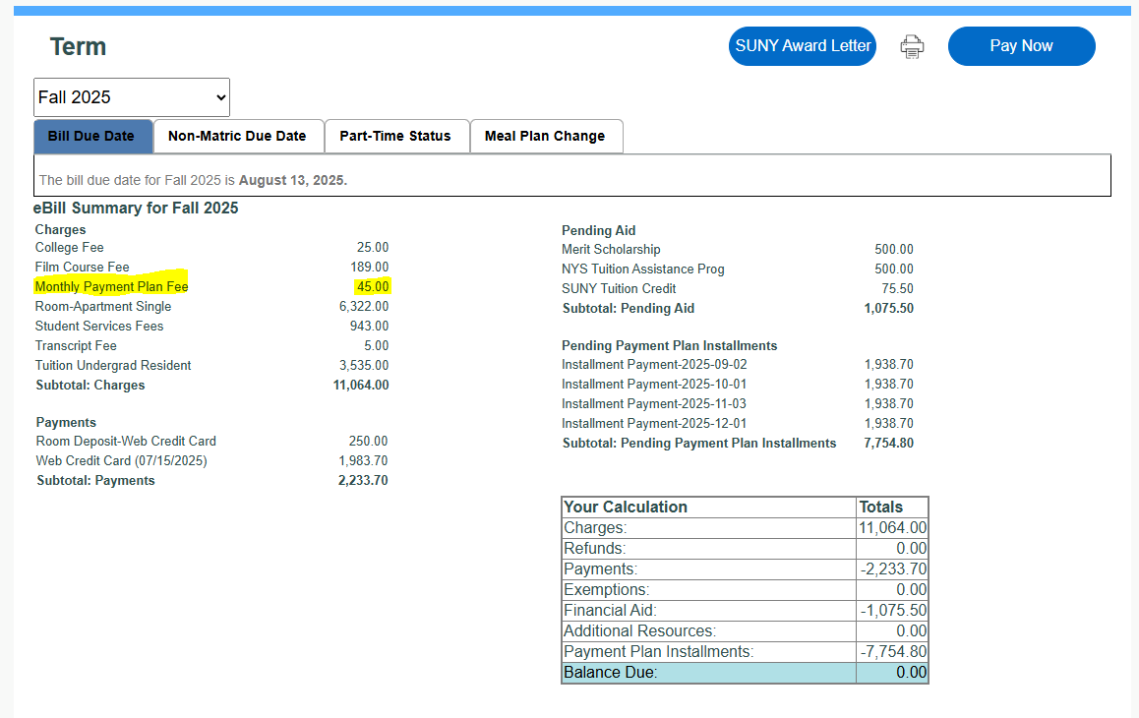
Student with a balance… enrolled in a Payment Plan:

Slide 11
Refunds
E-refunds ☺
Quick and easy way to get your money! Set up a direct deposit profile using a bank account of your choice. receive money in 3-5 days. Set up is through myHeliotrope
Paper check ☹
If you do not have a bank account to set up an e-refund profile please contact the office of student financial services to request a paper check to be mailed to your home address.
  This process will take longer to receive than an e-refund profile

Slide 12
Q&A & Tips
Need Help Reach out to our office (in-person , Zoom, Email, Phone)
Monitor your Purchase Email on regular basis ALL offices will have direct contact with you through your Purchase email.
Make sure to complete your FAFSA and TAP application on an annual basis (Available October 1st 2026)
Finish your degree on time or early to save money
Special Circumstances Appeal
Learn about smart borrow & financial literacy with your Federal Student Loans and avoid borrowing more than needed
Look into working on campus as a Work Study Student/RA/Student Assistant to help with your own personal expenses
How to contact Student Financial Services Office:
    SFS@purchase.edu

