Slide 1



Time and Attendance System for Classified Service Employees

Slide 2
1) Sign –in to SUNY HR Time and Attendance using existing User ID and password.
Overview of Time and Attendance System (TAS) For Classified Service Employees
Select an Accrual Period (Pay period)
Enter Time In and Time Out for each day worked.
Enter and submit Request Time Off to charge accruals within the pay period (vacation, sick, etc).
Certify and Submit Time Record to your Supervisor.
Sign-out of SUNY Browser and Close

Slide 3
First-time System Sign-in Information
For security reasons your sign-in will be different the first time you enter into the Time and Attendance System. You will be asked for your SUNY ID (which is provided by your campus) and your date of birth (DD/MM/YYYY).
Once you complete this security procedure, you will not need to verify your information.

Slide 4
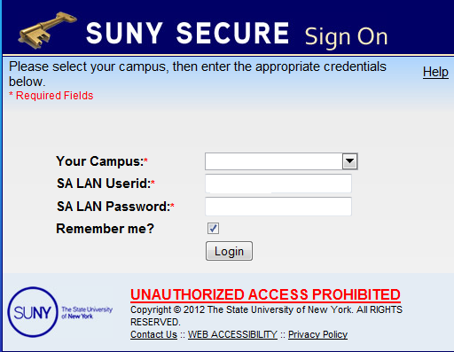
Sign in to SUNY at: http://www.suny.edu/time
Bookmark
As described in the previous slide, the screen will be slightly different your first time signing in, requesting your SUNY ID and DOB. That is a one-time security occurrence. Going forward, your entry screen will look like this:
User ID and Password

Slide 5
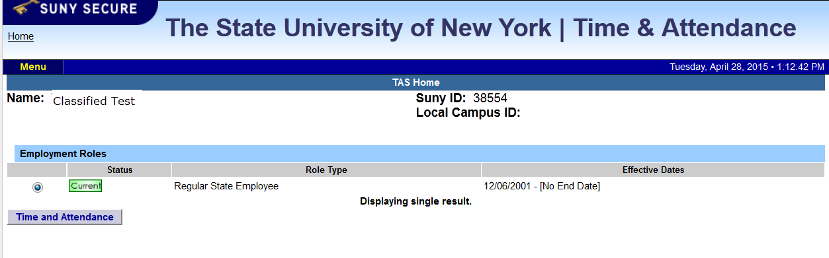
Once logged into TAS, the home page will be displayed. This includes employee
information and employment roles. To begin using TAS, click on “Time and Attendance” tab.

Slide 6

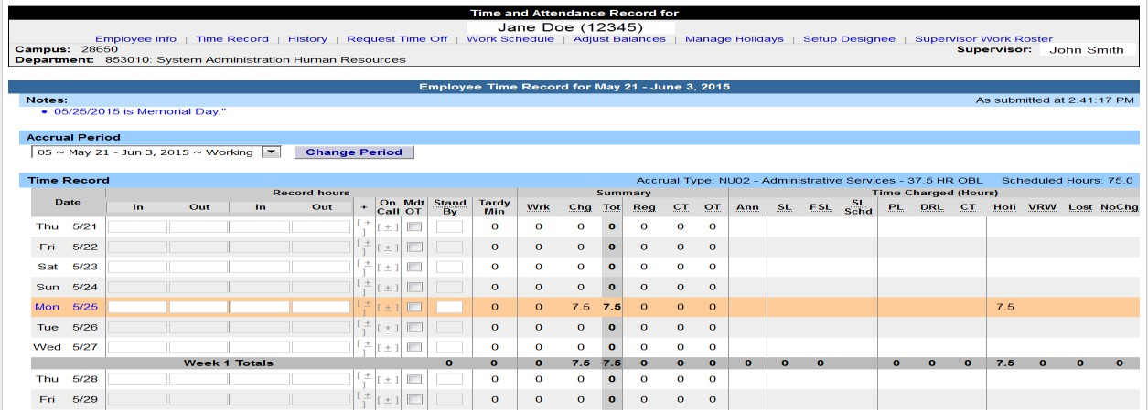

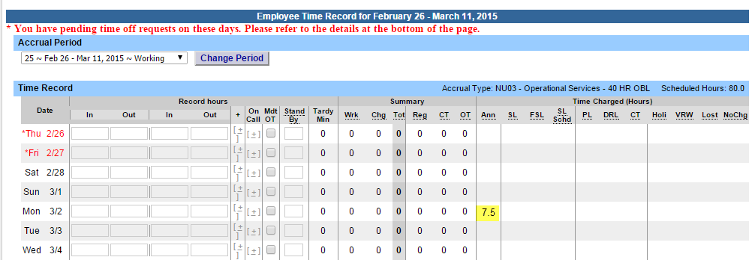
Time record:
Time record will automatically open to the current pay period in which you have been set up to being entering. To change pay periods, select from the drop down shown below and click change period.
Enter time in and time out in the fields indicated below with time worked each day. Enter A for AM and P for PM. Military time is also accepted.
If you need additional fields, please click on the first (+) button. This will open up more time in and out fields on the particular day.
If employee works overtime, please indicate whether it was mandatory overtime by selecting the box under the Mdt OT column.
To enter time for on-call (recall), please click on the (+) button under the on-call column and enter time worked.
If employee had stand by shifts, please indicate number of shifts under the Stand By column.
Once time worked has been entered, TAS will calculate the time worked within the summary columns (worked, charged, total, regular, comp time and overtime).
Time charged hours are only displayed on the time record once the time off request has been approved by the supervisor (highlighted in yellow). To charge accruals, employees must submit a time off request to their supervisors. See Time off Request section.
If an employee has pending time off request, the date of the request will appear on the time record in red with a note displayed at the top of the time record, indicating your pending request.
•
•
•
•
•
•
•
•

Slide 7
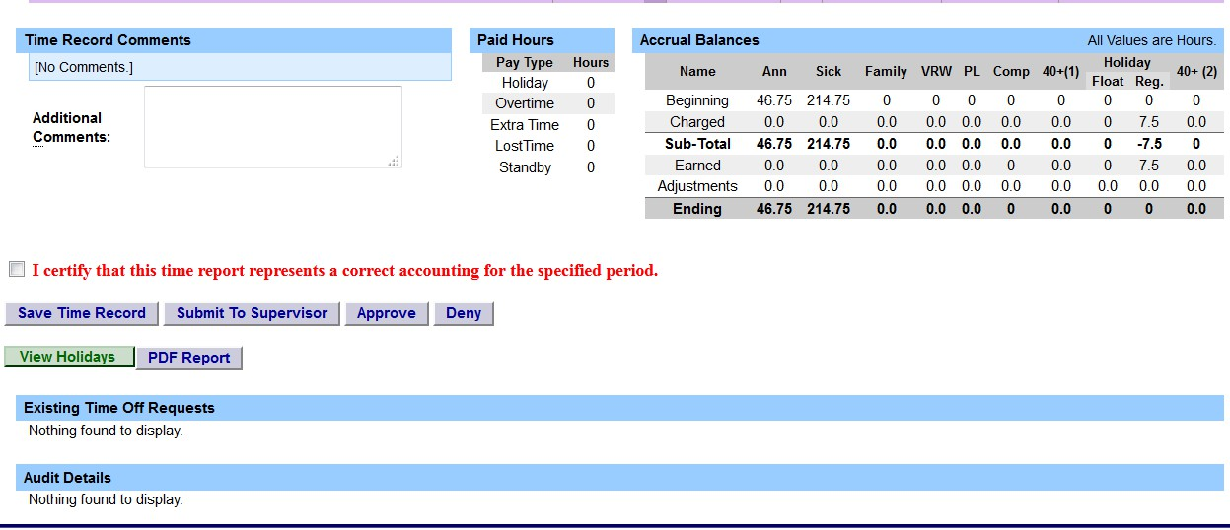

Other features on the Time Record
Enter comments in the box indicated below if you wish to submit comments to your supervisor on your time record.
Paid Hours – total number of hours entered within the pay period for each pay type (Holiday, Overtime, Extra Time, Lost Time, Standby)
Accrual Balances – summary of accrual balances for each accrual type and any amount charged within the pay period.
View Holidays – list of all holiday/floaters that have been earned, charged and expiration date.
PDF Report - Printable time record.
Existing Time off Requests will be displayed.
Audit Details of when time records have been submitted and action has been taken.
Comments
View
Holidays and PDF Report

Slide 8

Certify and Submit to Supervisor
When time record is complete, either certify and submit to supervisor or save time record to submit at a later
time.
To send to your Supervisor, click on the “I Certify” box and select Submit to Supervisor
NOTE: You will receive the pop up message if you navigate away from your time record in which changes were made and was not save or submit to their supervisor.

Slide 9
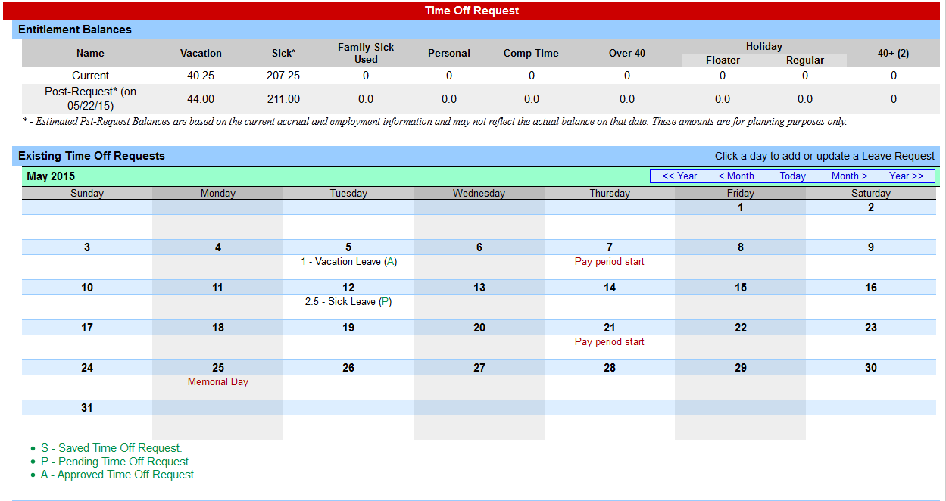
To Enter Time off Requests:
Double click on the day you wish to enter the accrual charge. From the
pop up box (shown on the next page), you will enter appropriate accruals.
Double click on the day to enter charges.

Slide 10
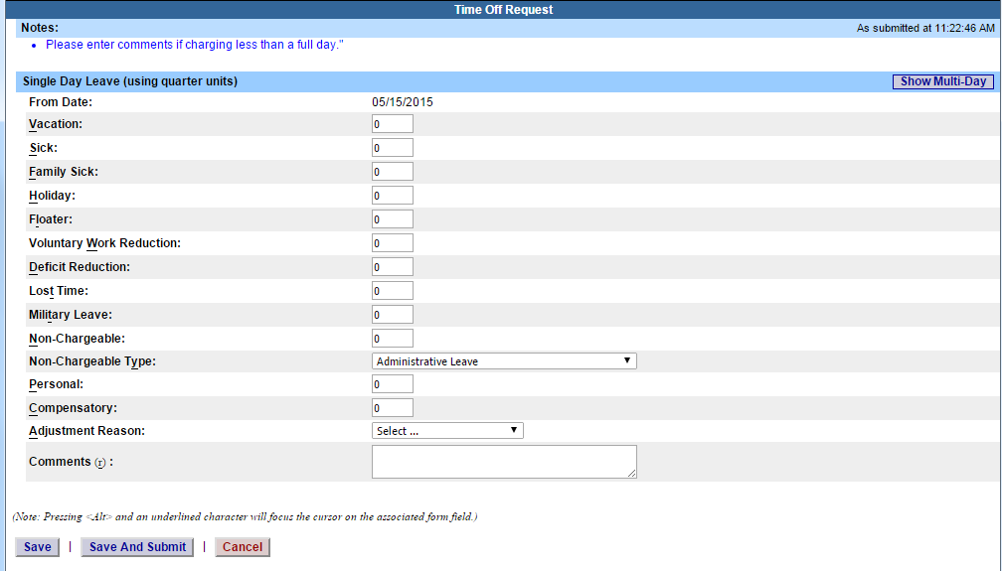
Time Off Request – continued
The pop up opens up a single day request (shown on the left). To enter a date range, select the Show Multi Day button shown on the right (shown on next screen). Enter the increment (increments of .25 hours only) in the accrual type you want to charge, then select Save or Save and Submit. Once approved, the accrual charge will appear on your time record.
Single Day
Multi-Day

Slide 11
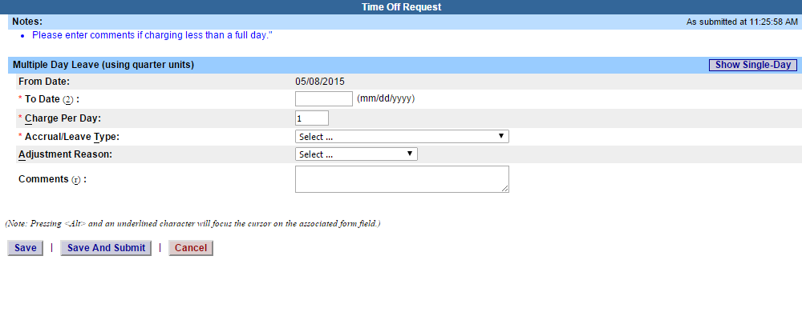
Multiple Day Time off Request:
Enter the increment (increments of .25 hours only) in the accrual type you wish to charge, then select Save or Save and Submit.
Save – will allow employees to enter the time off request but not submit the request to the supervisor
Save and Submit – allows employees to save and submit
the request all at once to the supervisor.
Reminders:
Pending Time off Request - the date of the request will appear on the time record in red with a note displayed at the top of the time record, indicating your pending request (see screen print under time record).
Approved Time off Request – will appear under the time charged section of the time record (see screen print under time record).
Charge accruals can not span across multiple pay period.
If a holiday falls within a time charged, a separate entry must be submitted, excluding the holiday.

Slide 12
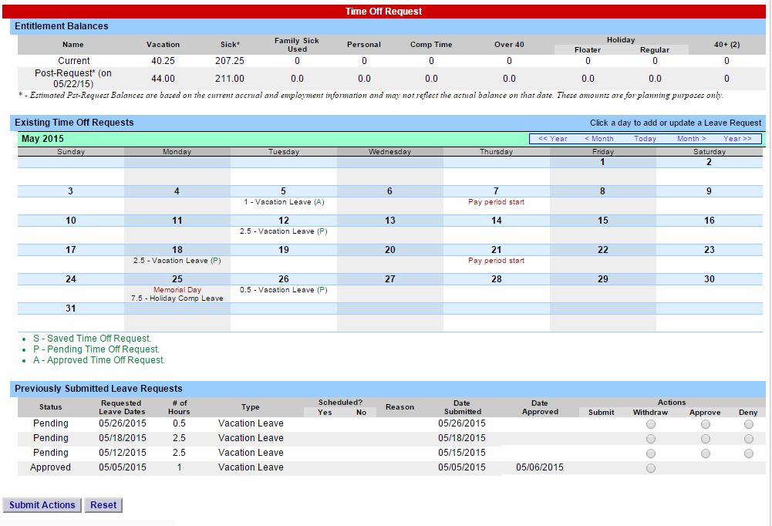
Status of Time off Requests:
Reminders:
Once the request has been saved or save/submit, it will appear on the calendar and under the Previously Submitted Leave Request along with the status (Saved, Pending and Approved). If you have not submitted the request to your Supervisor, select the radio button and click Submit Action. Once approved, the request will appear on the corresponding time record.
The status of your request will also appear in parenthesis on your monthly time record (S, P, A).
To withdraw a previously submitted leave request that has not been approved by the supervisor, simply select the withdraw radio button next to the associated request and then click Submit Actions.
Employees will have the ability to submit a time record with pending time off request.
Time off requests can not span across multiple pay periods.
If a holiday falls within a time off request, a separate entry must be submitted, excluding the holiday.
f
f

Slide 13

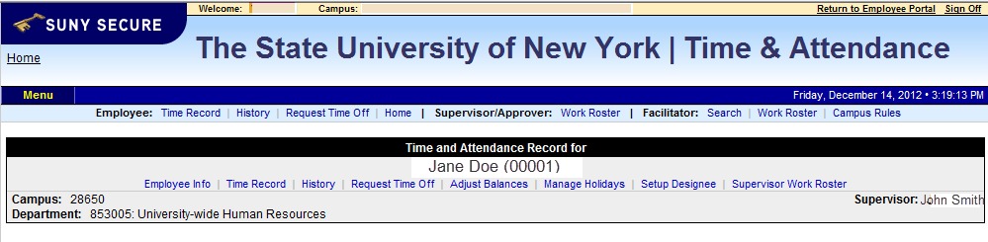
Sign out of the SUNY browser and CLOSE
To ensure your privacy and system security, please log off by clicking on “Sign Off” link in the upper right hand corner of your screen.

Slide 14
CONGRATULATIONS!
For those of you without direct reports, once you have entered your current Time and Attendance Information, you have successfully completed the training session.
Step by Step instructions are also available for your use.
Supervisors, there are a few more slides about the process for approving time records and/or time off requests for your employees.

Slide 15

Time and Attendance System (TAS)
Supervisors
Step-by-Step

Slide 16
1) Sign in to SUNY HR Time and Attendance
Overview of Monthly Time and Attendance Process – For Supervisors
Select “Work Roster.”
View employee’s Time Record and/or Time Off Requests.
Select “Approve,” “Deny,” or even “Postpone”
Select “Submit”

Slide 17
Sign in to SUNY at:
http://www.suny.edu/time
Bookmark
As described in a previous slide, the screen will be slightly different the first time you log in, requesting your SUNY ID and DOB. That is a one-time security occurrence. Going forward, your entry screen will look like this:
Suny ID and Password

Slide 18
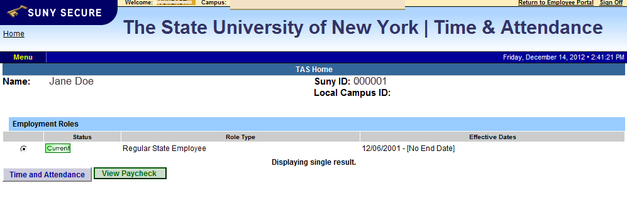
Then, click on
“Time and Attendance” Tab to get into your time record

Slide 19


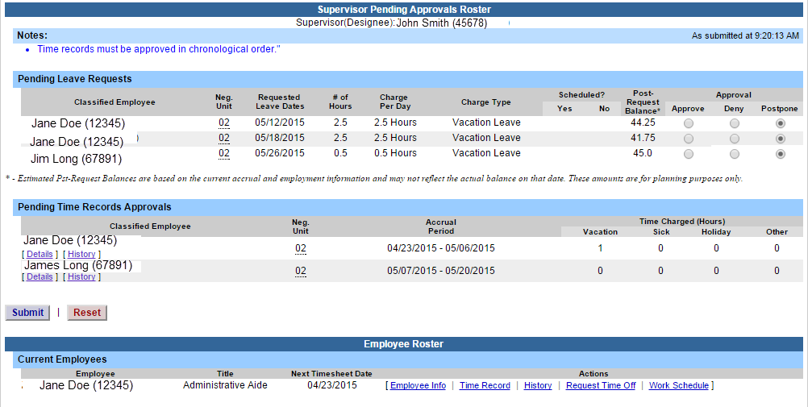
Supervisor Work Roster:
Click on “Work Roster,” to view the pending time records and/or time off request, of your employees.

Slide 20
SUPERVISOR WORK ROSTER (CONTINUED):
Pending Leave request – must be approved before any time records within the same pay period.
Determine the necessary Action (approve, Deny, or Postpone)
**Denied action requires comments for the employee’s Information.
Then, “Submit”
Pending Time records – Supervisors must View Employee’s Electronic Time Record by clicking on
Details under the employees name. This will bring up the completed time record for the employee.
Once time record has^{Ig}b^{n}e^{or}e^{e}n reviewed, determine
the necessary Action (Approve or Deny)
**Denied action requires comments for the employee’s Information.
If […] icon appears under an employee’s name, this indicates the employee is also a supervisor within the department. If you click on the […] icon their supervisor work roster will be brought up, and you have all the same supervisor privileges.
Required action for Time off Request
View Details or History of Time Record
3) Submit
Submit action for pending Time off Request

Slide 21
TO TAKE ACTION ON A PENDING TIME RECORD ONCE THE SUPERVISOR HAS CLICKED ON DETAILS FROM THE WORK ROSTER AND REVIEWED THE TIME RECORD, PLEASE CLICK APPROVE OR DENY.
ONCE ACTION HAS BEEN TAKEN, THE PENDING TIME RECORD WILL BE REMOVED FROM THE WORK ROSTER.
IF APPROVED, THE TIME RECORD WILL CHANGE TO AN APPROVED STATUS UNDER THE ACCRUAL PAY PERIOD DROP DOWN
IF DENIED, THE TIME RECORD WILL SHOW AS DENIED WITH REQUIRED COMMENTS FOR THE EMPLOYEE TO CORRECT AS NECESSARY AND RESUBMIT TO SUPERVISOR.
Ignore
Approve or Deny

Slide 22
Sign out of the SUNY browser and CLOSE
To ensure your privacy and system security, please log off by clicking on “Sign Off” link in the upper right hand corner of your screen.

Slide 23
Thank You!
Step by Step instructions are also available for your use.
Please contact any member of the HR Time and Attendance implementation team if we can be of further assistance.

