Slide 1

Electronic Time and Attendance System
Guide for FT and PT UUP and MC Employees
(Faculty, Staff and Supervisors)

Slide 2
Overview of Monthly
Time and Attendance System (TAS) For All Employees
Sign –in to SUNY HR Time and Attendance
Select an Accrual Period (Month)
Enter Charges for Vacation, Sick, or Other Used Time
Request Time Off
Certify and Submit Time Record for Supervisor Approval
Sign-out of SUNY Browser and Close

Slide 3
First-time System Sign-in Information
For security reasons your sign-in will be different the first time you enter into the Time and Attendance System. Here, you will be asked for your SUNY ID and your DOB.
Once you complete this security procedure, your sign-in will appear differently going forward. There will be no need for you to use your SUNY ID again for this process.

Slide 4
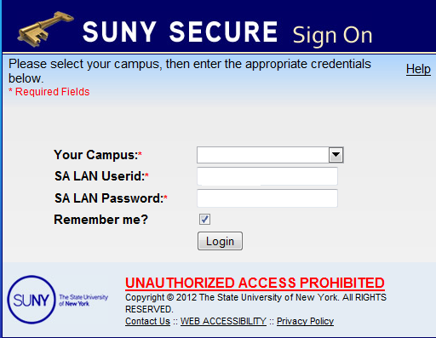
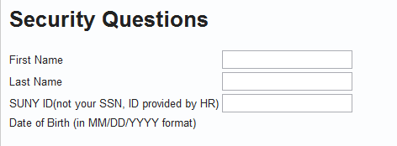
Sign in to SUNY at: https://www.suny.edu/time
Bookmark
As described in the previous slide, the screen will be slightly different your first time in. You will be required to enter your SUNY ID and DOB.
First, you will encounter a Sign-on screen
Next, you will come to a one-time security screen
As described in the previous slide, the
For security reasons your sign-in will be different the first time you enter the Time and Attendance System - use the SUNY ID provided by HR for the third question.
Purchase ID and
Password

Slide 5
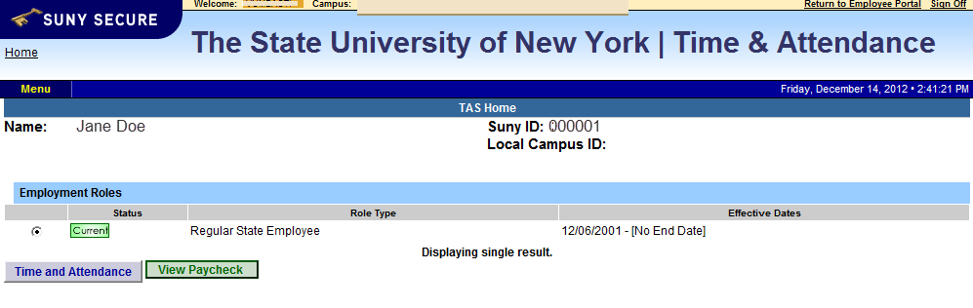
Accessing your Time Record
Click on “Time and Attendance” Tab to work on your time record

Slide 6
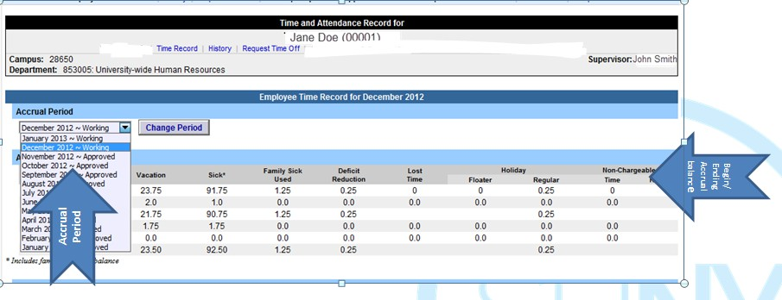
MC and UUP Staff Time Record
Time record will automatically open to the current month. To change to a previous month select from the drop down shown below. Employees can only see their time records from the date the system was implemented at Purchase College in 2014.
The status of any given month is reflected
here in the above drop-down:
Working: Open for you to make entries Pending: Submitted to your supervisor Approved: Reflected once Supervisor has
signed-off
30 days contractual Family Sick Leave Tracked Here, Deducted from Sick. Family Sick charges relate to the medical care of a direct family member.
Non-Chargeable Time (Such as conferences, jury duty, off-site meetings, etc.) Tracked Here, Not Deducted

Slide 7
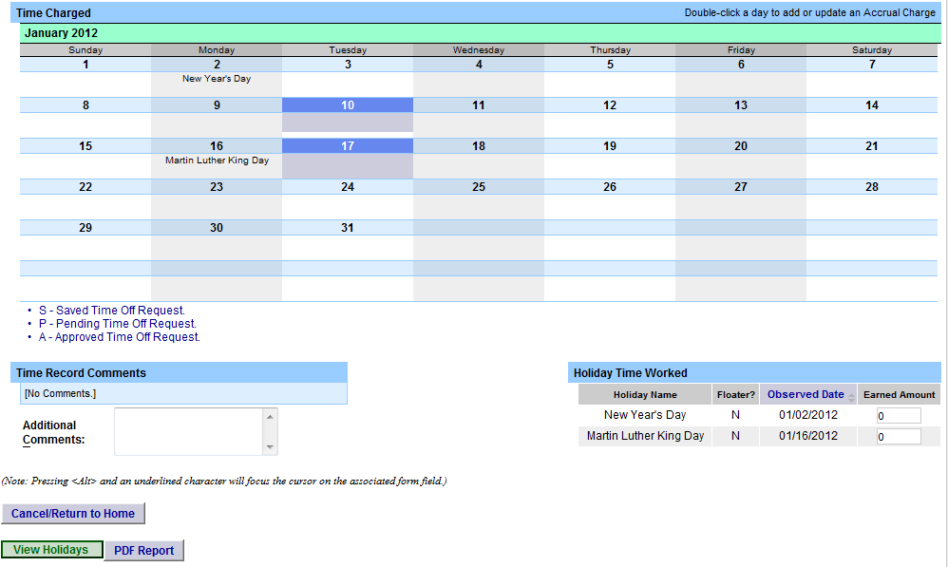
Charging Vacation, Sick, or Other Time
Double click on the day you wish to enter the accrual charge. From the pop up box (shown on the next page), enter the appropriate accrual charge/s.
Double click on the day to enter charges.

Slide 8
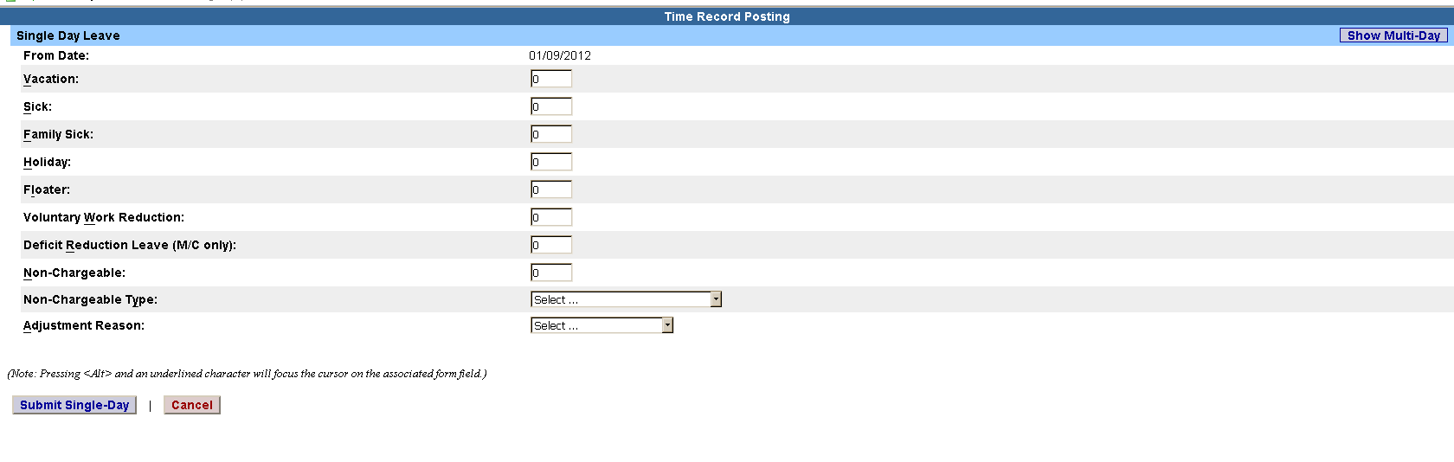
View of Sub-Menu Produced by Clicking on Individual
Calendar Dates
The pop up opens up a single day request (shown on the left). To enter a date range, select the Show Multi Day button shown on the right (shown on next screen). Enter the increment (increments of .25 days only) in the field which you want to charge, then select Save. Once saved, the accrual charge will appear on your time record.
Multi-Day
Single Day

Slide 9
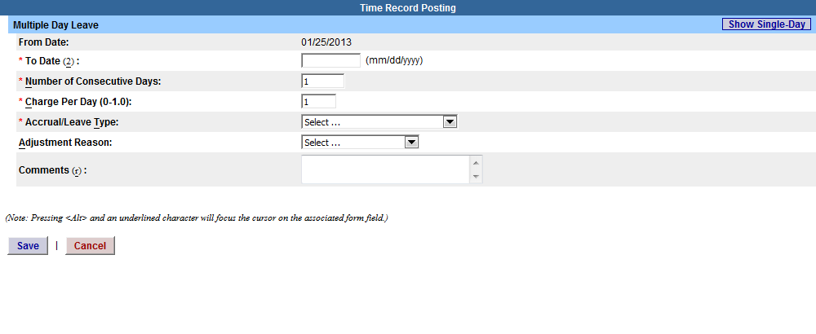
Multiple Day Leave
Reminders:
Charge accruals can not span across
multiple months.
If a holiday falls within a time charged, a separate entry must be submitted, excluding the holiday.

Slide 10
Other features on the Time Record
Comment Section: Enter comments in the box indicated below if you wish to submit comments to your supervisor on your time record. (Comments should be kept strictly professional since they cannot be removed)
Holiday Time Worked – Holiday/Floaters that fall within the month. These dates are preset by your campus calendar.
View Holidays – list of all holiday/floaters that have been earned, charged and expiration date.
PDF Report - Printable time record.
•
•
•
Comments
Holiday/Floaters
Holiday Time Worked - Standard holidays such as: New Years, MLK Day, Memorial Day, Independence Day, Labor Day, Columbus, Veteran’s day, Thanksgiving and Christmas will automatically be charged “0” as an Earned Amount because it’s anticipated that most employees will not be working these days. If an employee has worked the holiday they can go in and change the Earned Amount to 1
View
Holidays
and PDF
Report

Slide 11
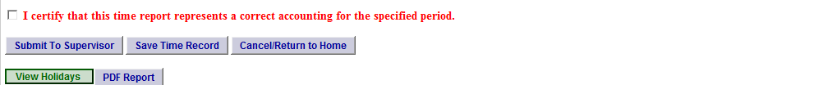
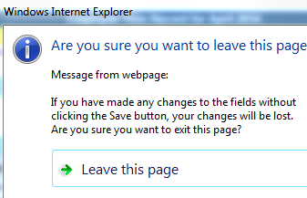

Certify and Submit to Supervisor
When a time record is complete, either certify and submit to your supervisor or save the time record to submit at a later time.
To send to your Supervisor, click on the “I Certify” box and select Submit to Supervisor
NOTE: You will receive a pop up message if you try to navigate away from your time record (where changes were made) if it was not saved or submitted to your supervisor.
mit

Slide 12
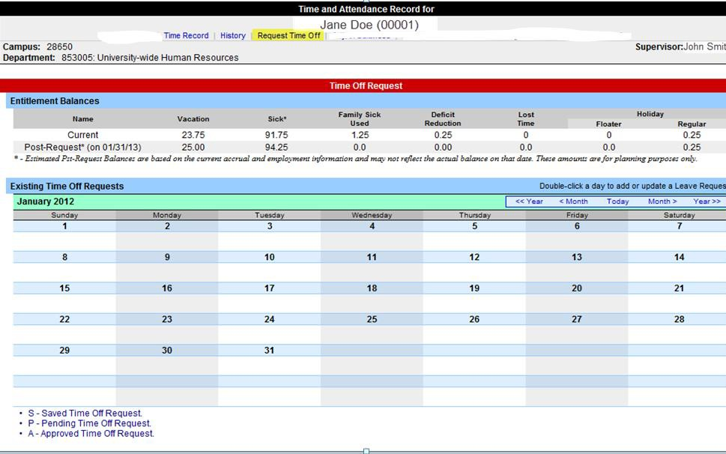
Requesting Time Off
For prior approval for time off, click on the Request Time Off link highlighted
below. Then double click on the day you wish to request off on the calendar.

Slide 13
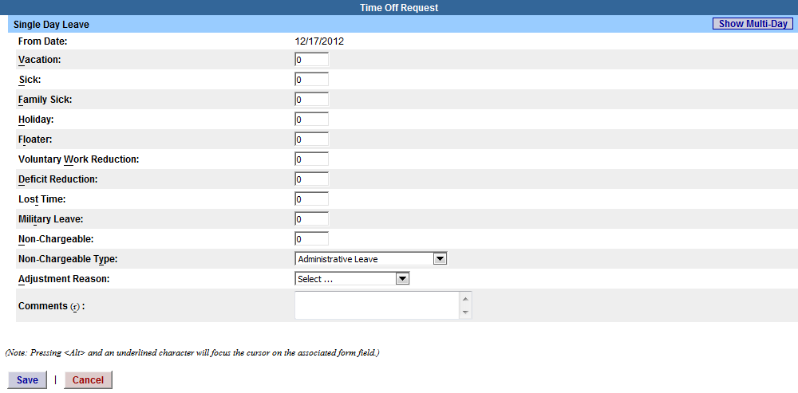

Requesting Time Off
The pop up opens up a single day request (shown on the left). To enter a date range, select the Show Multi Day button shown on the right. Enter the increment (increment of .25 days only) and accrual you wish to charge and click save.
Single Day
Multi-Day

Slide 14
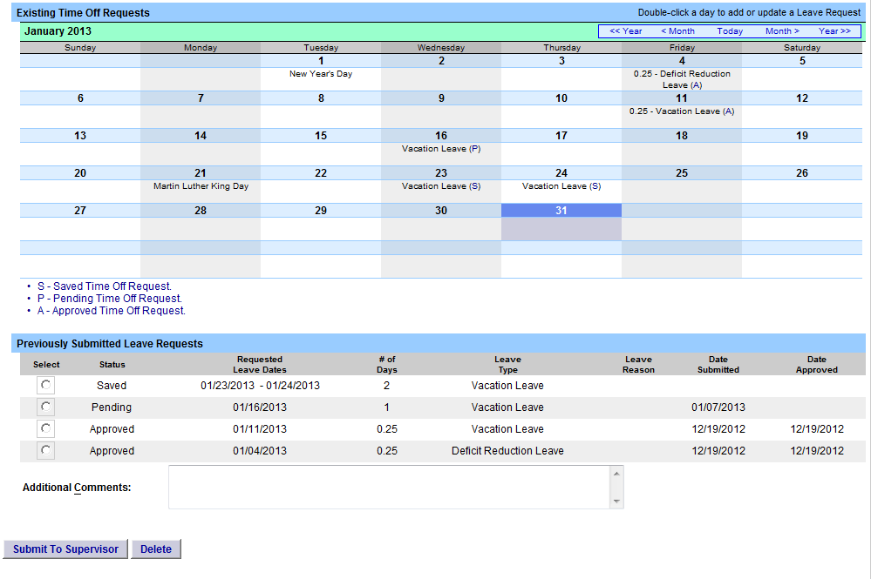
Requesting Time Off
Once the request has been saved, it will appear on the calendar and under the Previously Submitted Leave Request along with the status (Saved, Pending and Approved). To submit the request to your Supervisor, select the radio button and click Submit to Supervisor. Once submitted, the request will appear on the monthly time record.
Reminders:
The status of your request will also appear in parenthesis on your monthly time record (S, P, A).
If you need to change a time off request and it has not been approved by your supervisor, you must currently be on your Time Off Request calendar. Double click on the day to update.
To delete a previously submitted leave request, simply select the radio button next to the associated request and then click delete.
Employees will be unable to submit a time
record with pending time off request.
Time off requests can not span across multiple months.
Status of Time Off Request
Select radio button and submit

Slide 15
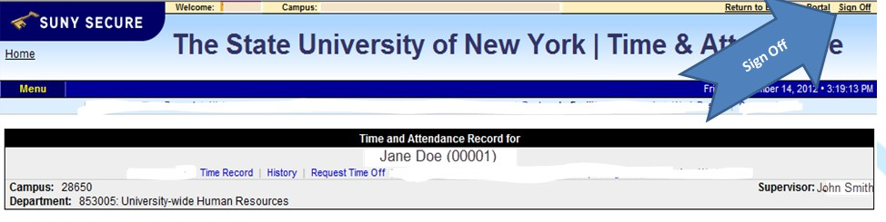
Sign out of the SUNY browser and CLOSE
To ensure your privacy and system security, please log off by clicking on “Sign Off” link in the upper right hand corner of your screen.

Slide 16
Time and Attendance System (TAS)
Faculty Time Record

Slide 17
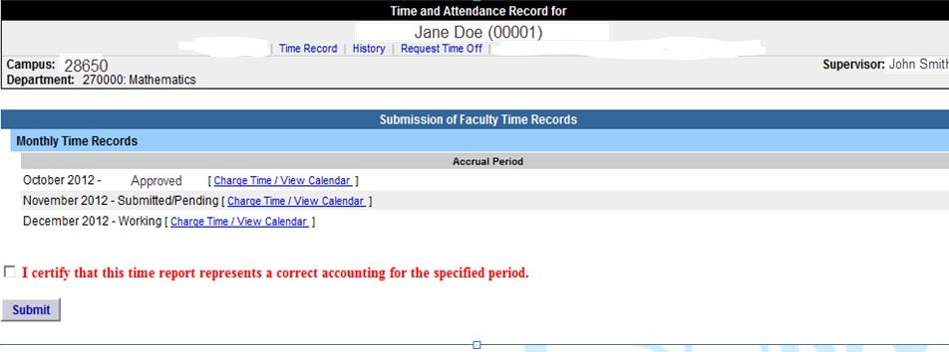

Faculty Time Record
Faculty employees are able to certify and submit their time records directly from their summary page (shown below), if there are no charges within the month. You will only be able to submit one time record (the earliest working one) at a time.
To submit with no time charged, simply click “I certify” box and then submit. Once submitted, it will go
into Submitted/Pending status until approved by supervisor.
To charge time, select “Charge Time/View Calendar” and you will be brought into your time record
calendar as shown on the following slide.
Click on SUBMIT if you have NO SICK LEAVE to record.

Slide 18
View of Sub-Menu Produced by Clicking on Individual Calendar Dates
Double click on the day you wish to enter the accrual charge. From the pop up box (shown on the next page), enter the appropriate accrual charge/s.
Double click on the day to enter charges.

Slide 19
Charging Sick Time
The pop up opens up a single day request (shown on the left). To enter a date range, select the Show Multi Day button shown on the right (shown on next screen). Enter the increment (increments of .25 days only) in the field which you want to charge, then select Save. Once saved, the accrual charge will appear on your time record.
Multi-Day
Single Day

Slide 20
Multiple Day Leave
Reminders:
Charge accruals can not span across multiple months.

Slide 21
Certify and Submit to Supervisor
When time record is complete, either certify and submit to supervisor or save time record to submit at a
later time.
To send to your Supervisor, click on the “I Certify” box and select Submit to Supervisor
NOTE: You will receive a pop up message if you try to navigate away from your time record (where changes were made) if it was not saved or submitted to your supervisor.
mit

Slide 22
Other features on the Time Record
Comment Section: Enter comments in the box indicated below if you wish to submit comments to your supervisor on your time record. (Comments should be kept strictly professional since they cannot be removed)
PDF Report - Printable time record.
Comments
View
Holidays
and PDF
Report

Slide 23
Sign out of the SUNY browser and CLOSE
To ensure your privacy and system security, please log off by clicking on “Sign Off” link in the upper right hand corner of your screen.

Slide 24
CONGRATULATIONS!
For those of you without direct reports, once you have entered your current Time and Attendance Information, you have successfully completed the training session.
These Step by Step instructions can be viewed on
HR’s Website
Supervisors, there are a few more slides about the process for approving time records and/or time off requests for your employees.

Slide 25
Time and Attendance System (TAS)
Supervisor’s Guide

Slide 26
Overview of Monthly Time and Attendance Process –
For Supervisors
Sign in to SUNY HR Time and Attendance
Select “Work Roster.”
View employee’s Time Record and/or Time
Off Requests.
Select “Approve,” “Deny,” or even “Postpone”
Select “Submit”

Slide 27
Sign in to SUNY at:
http://www.suny.edu/time
Bookmark
As described in a previous slide, the screen will be slightly different the first time you log in, requesting your SUNY ID and DOB. That is a one-time security occurrence. Going forward, your entry screen will look like this:
Suny ID and Password

Slide 28
Accessing your Time Record
Click on “Time and Attendance” Tab to get into your time record

Slide 29
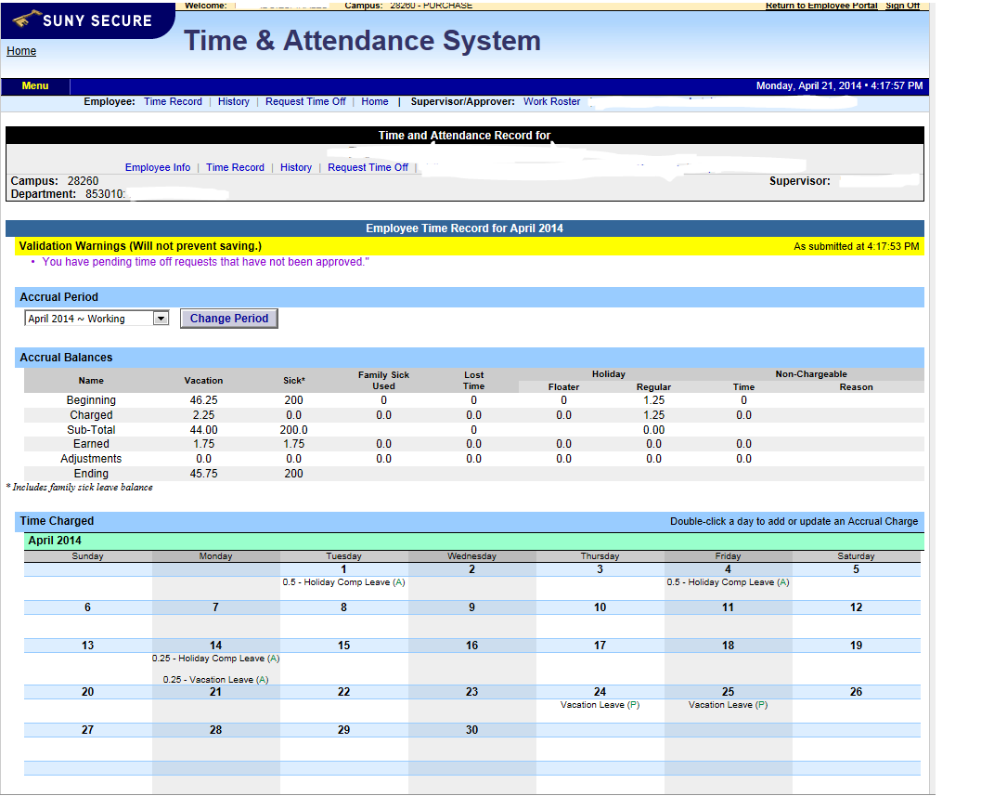

Supervisor’s Work Roster
Once you’ve selected the Time and Attendance tab, your own Time Record will open. Select the “Work Roster” tab to view the Pending
Time Records and/or Pending Leave Requests (time off request) of your employees.

Slide 30
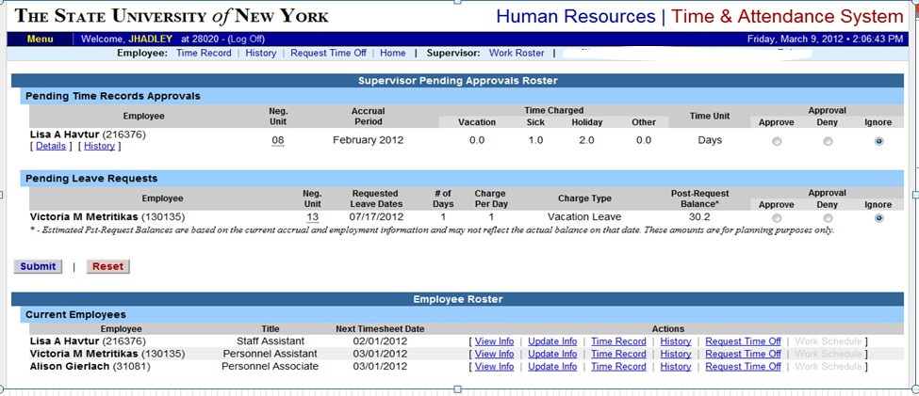
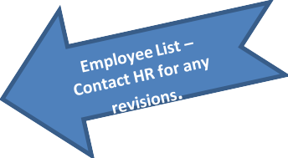
Supervisor Work Roster
After you’ve selected the Work Roster tab any Pending Time record/s and/or Pending Leave
Requests (time-off requests) for your employees will appear.
For PENDING TIME APPROVALS OR LEAVE REQUESTS –
Supervisors should select an action: APPROVE, DENY, OR IGNORE. THEN SUBMIT.

Slide 31
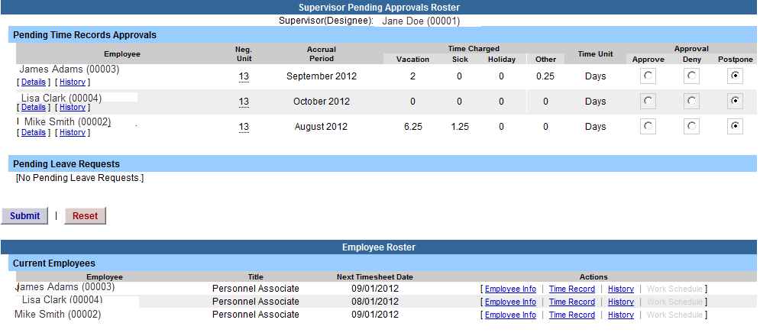
SUPERVISOR WORK ROSTER
ON THIS PAGE SUPERVISORS CAN:
VIEW EMPLOYEE’S ELECTRONIC TIME RECORD
DETERMINE AN ACTION (APPROVE, DENY, OR POSTPONE) ANY DENIED ACTION REQUIRES COMMENTS FOR THE EMPLOYEE’S
INFORMATION.
“SUBMIT”
IF […] ICON APPEARS UNDER AN EMPLOYEE’S NAME THIS INDICATES THE EMPLOYEE IS ALSO A SUPERVISOR WITHIN THE DEPARTMENT. IF YOU CLICK ON THE […] ICON THEIR SUPERVISOR WORK ROSTER WILL BE BROUGHT UP, AND YOU HAVE ALL THE SAME SUPERVISOR PRIVILEGES.
1) View Details or History of Time Record
2) Required action
For PENDING TIME APPROVALS OR LEAVE REQUESTS –
Supervisors should select an action: APPROVE, DENY,
OR POSTPONE. THEN SUBMIT.
3) Submit
4) Denotes Supervisor

Slide 32

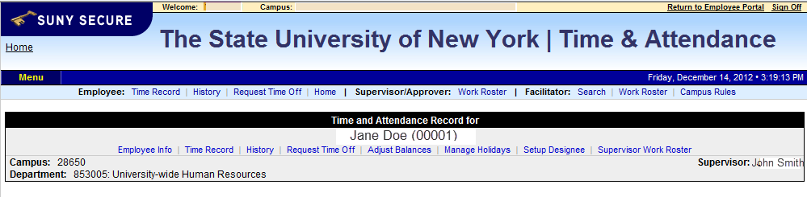
Sign out of the SUNY browser and CLOSE
To ensure your privacy and system security, please log off by clicking on “Sign Off”
link in the upper right hand corner of your screen.

Slide 33
Time and Attendance System (TAS)
Setting up a Designee

Slide 34
Setting up a Designee
A Designee: – refers to a person who has been designated to perform some duty or carry out some specific role.
Types of Designee within TAS:
*Employee Designee – designate another employee the ability to enter monthly time records for a specific period of time or indefinitely on behalf of the employee.
Supervisor Designee – designate another employee/supervisor the ability to take action (approve/deny) on all pending time records and/or time off request.
*Note: The original employee’s signature is still required to support the time record. This can be attained by a hard copy the employee completes and gives to the Designee to enter into the system or the electronic PDF that once the information has been entered can be printed out for the original employee’s signature.
The use of a supervisory designee should be limited and the responsibility should be understood by all parties involved. The designee to approve timesheets should be someone in the supervisory chain because of the liability issues related to the approval of a timesheet. The person who approves the timesheet is ultimately responsible for the accurate reporting of the information they approve.
Requesting a Designee
Both an employee and supervisor are required to complete a Designee Form. Once a Designee Form has been signed by the Employee, the Employee’s Supervisor and the Designee, the form must be submitted to the Payroll Office for review and authorization by a Payroll Facilitator. Once the facilitator signs the Designee Form, the designee will be setup in the system. No designee assignments will be setup without a fully endorsed designee form.

Slide 35
Setting up a Designee
Once the Designee has been established, they will appear on the Current Proxies (shown below). This also indicates which role they have been assigned, Employee Designee, Supervisor Designee and/or Approver Designee.
To end a Designee after it has been created, click on the radio button next to the employee’s name you wish to work on
and enter the appropriate end date.
To remove a Designee, click on the radio button next to the employee’s name you wish to work on and make the end
date equal to the effective date.

Slide 36
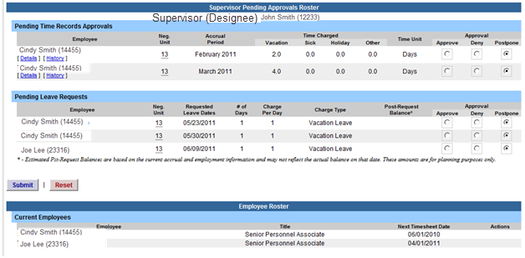
Setting up a Designee
To Work on the Supervisor/Approver: Work Roster:
Click on the corresponding link on the tool bar (highlighted below in yellow).
The Supervisor Designee Roster will appear (shown below).
If Designee currently has supervisor responsibilities, their work roster will appear at the top of the page.
The Supervisor/Approver Work Roster will be displayed under the Employee Roster (highlighted below in yellow).
To begin working on the roster click on the […] icon (highlighted below in yellow) under the supervisor’s name.
Follow separate Supervisor instructions to begin working on the Work Roster.

Slide 37

Setting up a Designee
Employee Designee:
Once employee has been established as an Employee Designee, the Designee now has access to the employee’s time record,
request time off, and history by clicking on the link above (highlighted in yellow).
Once the Employee Roster is displayed, select the function you wish to work on (Time Record, Leave Request, and History). Follow separate instruction according to Negotiating Unit (UUP and MC, non-hourly).

Slide 38
E-MAIL NOTIFICATIONS
Time record submission is now officially a MONTHLY process.
System-generated e-mail reminders are sent out to employees, supervisors and
supervisor’s supervisor.

Slide 39
Thank You!
If you have any questions, please contact any member of the HR Time and Attendance implementation team.
Susan Ciliberti
Time and Attendance Coordinator
Susan.ciliberti@purchase.edu
914-251-6057
Robin Farrell Payroll Manager
robin.farrell@purchase.edu
251-6096

