Slide 1

NYS Payroll Online Self Service*
July 2016
1

Slide 2


NYS Payroll Online Phases
Current Phase:
Future Phases:
View Paycheck
View Direct Deposit Account(s)
Update Pay Statement Option
Update Tax Withholding
View W-2
Update Email Address(es)
Update Address
Update Direct Deposit Account(s)
Update Name
Update Voluntary Deductions (SEFA, Deferred Comp, etc.)
*Please note that as of 2022, employees will need to setup Multifactor Authentication (MFA) to access the NYS Payroll Online System. Once you access the portal, select the "NYS Payroll Online" link under the Self Service option. Once you select the NYS Payroll Online option it will initiate the MFA setup. After the MFA has been setup you will be directed to the Payroll Online application as normal.
If you are logging into the NYSPO for the first time, the OSC User Verification Form would initiate right after the MFA. The User Verification Form may still require a user to fully close the browser after successfully submitting it the first time. Users that have already gone through OSC’s User Verification Form should not have to repeat this process. Please click on the following website link for a step-by-step guide on how to enroll/setup MFA -
NYS Payroll Online - Enrollment and Multifactor Authentication.
2

Slide 3


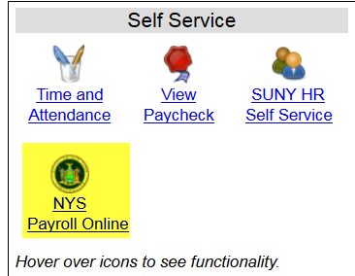
LOG IN TO NYS PAYROLL ONLINE
Go to: www.suny.edu/hrportal
Click on the “NYS Payroll Online” icon

Slide 4


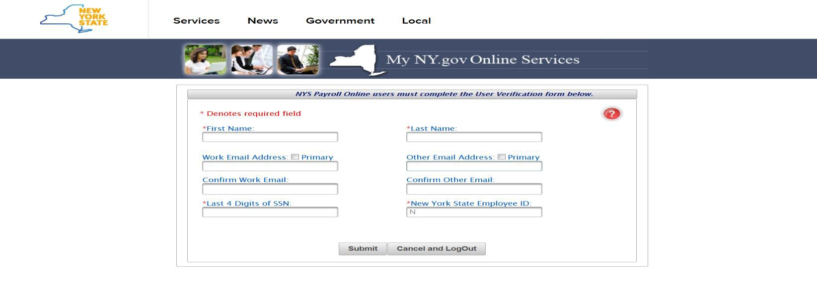
LOG IN TO NYS PAYROLL ONLINE
Complete the verification processes the first time you log in. Required fields:
  First/Last Name
  One Primary Email Address
  Last 4 digits of SSN
  New York State Employee ID - your nine-digit NYS Employee ID is found on your pay statement.

Slide 5


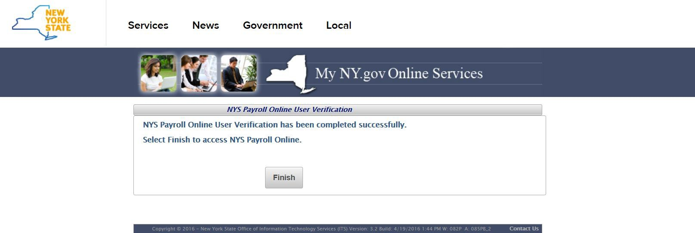
NYS Payroll Online Verification
Once you have completed the one time verification process, you will receive this confirmation.
Please click “Finish” to continue to the NYS Payroll Online Home Page.

Slide 6
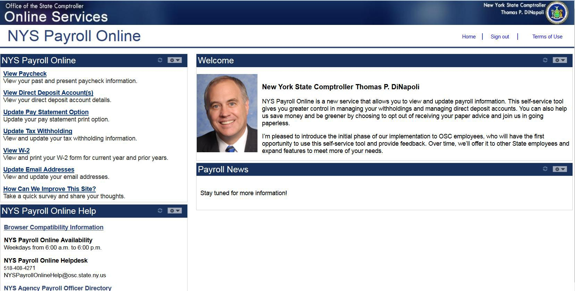
NYS Payroll Online Home Page

Slide 7


Pay Statements
View, Print and Save Your Pay Statement NYS Payroll Online provides access to view, print and save your pay statements. You will need Adobe Reader to view your pay statements in NYS Payroll Online.
Select View Paycheck from the left menu.

Slide 8
Pay Statements (continued)
The View Paycheck page displays the following items for each check listed:
Check Date
View Paycheck
Company
Pay Begin Date
Pay End Date
Net Pay
Paycheck Number

Slide 9
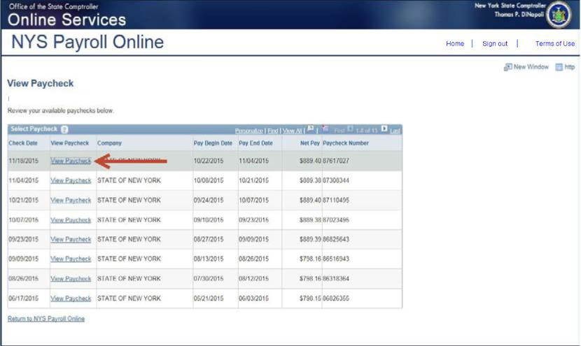
View Paycheck
Click View Paycheck to view all information for a specific paycheck.
NOTE: If you are using Internet Explorer, a new browser window will open and ask you if you want to Open or Save your pay statement. Click Open and it will open as an Adobe PDF document in a separate window. Close the Adobe PDF window when finished viewing your pay statement. Your pay statement will
remain open until you close this window, even if you log out or are timed out of NYS Payroll Online.

Slide 10



View Direct Deposit Account(s)
Select View Direct Deposit Account(s) from the left hand side menu.

Slide 11


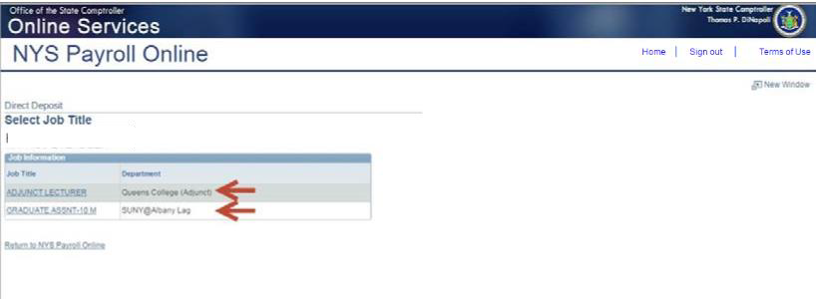
Direct Deposit (continued)
If you work in more than one State agency, you will be asked to select which agency you would like to view the direct deposit information for, then select the Job Title on the Select Job Title page to open the Direct Deposit page.

Slide 12
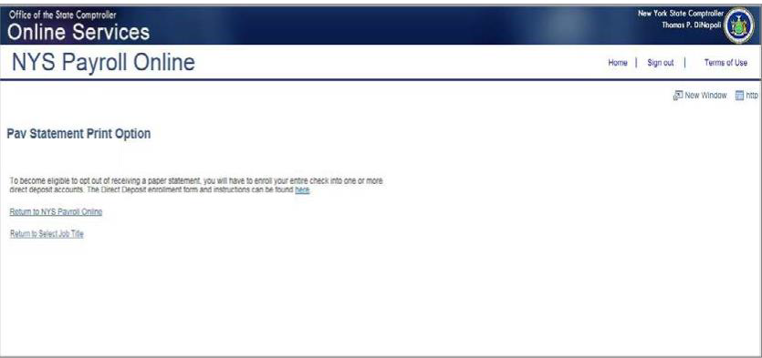
Direct Deposit (continued)
If you are not currently enrolled in direct deposit and have no banking information on file, you will receive the message below instead of seeing the Direct Deposit page.
Included on this page is a link to download the direct deposit form. If you want to participate in direct deposit,
complete this form and bring it to your payroll office to set up direct deposit for your paychecks.

Slide 13
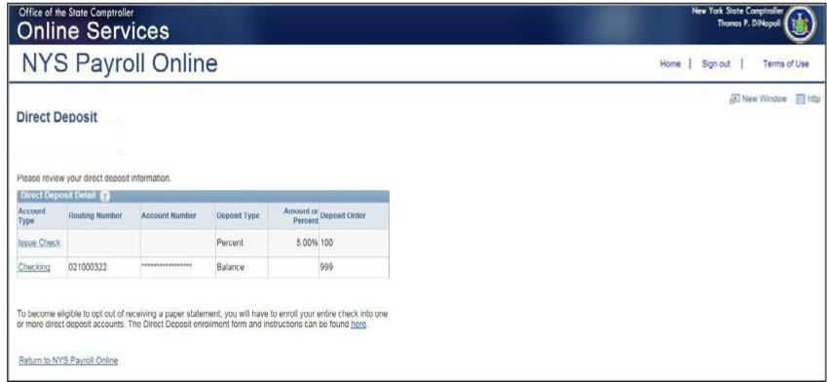
Direct Deposit (continued)
If you are enrolled in direct deposit, you can see detailed information about all of your current
direct deposit accounts on the Direct Deposit page.

Slide 14
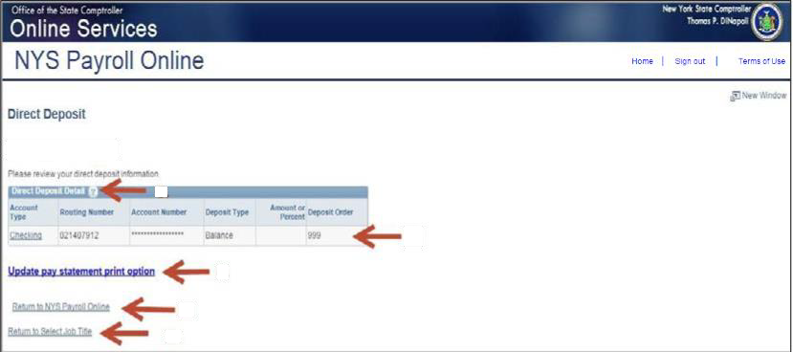
Direct Deposit (continued)
Deposit Order indicates the priority that your net pay will be deposited into multiple accounts. Deposit Order allows only values in increments of 100 with an end value of 999.
oExample:
oDeposit Order 100 = First Account Processed
oDeposit Order 999 = Last Account Processed
Click on the ? icon to view additional information about the Direct Deposit page.
Click Return to NYS Payroll Online to return to the NYS Payroll Online Homepage.
Click Return to Select Job Title to select a different Job Title on the Select Job Title page.
Click Update Pay Statement Print Option to update your preference to go paperless and opt out of receiving a printed copy of your direct deposit pay statement. Further information about going paperless and opting out of receiving a printed copy of your direct deposit pay statement, can be found in the NYS Payroll Online Update Pay Statement Option job aid.

Slide 15




Updating Pay Statement Option
Select Update Pay Statement Option from the left menu.
If you work for more than one State agency, then select the Job Title on the Select Job Title page to
open the Pay Statement Print Option page.
If you want to go paperless for all of your agencies you will need to complete the process below for EACH Job Title listed.

Slide 16
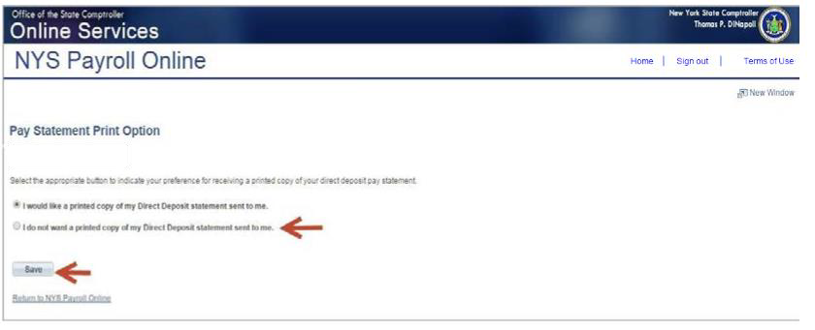
Updating Pay Statement (continued)
If you are enrolled in direct deposit, you will see the Pay Statement Print Option page. Select the radio
button to indicate “I do not want a printed copy of my Direct Deposit statement sent to me.”
Click Save

Slide 17
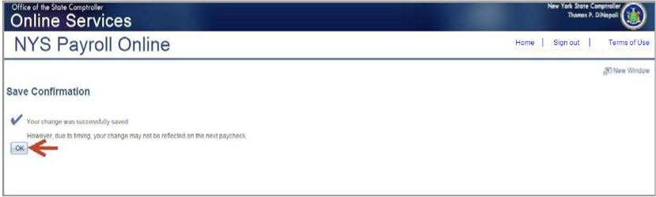
Pay Statement (continued)
An email will be sent to all email addresses stored in NYS Payroll Online when you make a change to your information along with the confirmation pop up shown below.
Click OK to return to the Pay Statement Print Option page.
NOTE: Due to timing, your change may not be reflected in your next paycheck. This is because the change may have been made too late for the payroll system to stop the printing of your most recent direct deposit pay statement. If this is the case, the change will take effect in an upcoming paycheck.

Slide 18
Updating Tax Withholdings
One of the most exciting features of NYS Payroll Online is that you now have the ability to review and maintain your own tax withholding information. New employees must still complete the paper W-4 (federal) and IT-2104 (NYS) tax withholding forms when they first become employed by New York State but all future changes can be done in NYS Payroll Online.
Current NYS employees can begin using NYS Payroll Online immediately to complete their New York State tax withholding changes.
NOTE: The system will only allow you to make changes to your tax withholding information once per day. Be sure to double check any changes before saving them in the system. If you enter inaccurate information you will not be able to correct it using NYS Payroll Online until the
•nex.t business day. However, your payroll office does not have to wait and can update it for
you in the payroll system the same day.

Slide 19



Updating Tax Withholding (continued)
Select Update Tax Withholding from the left menu.

Slide 20

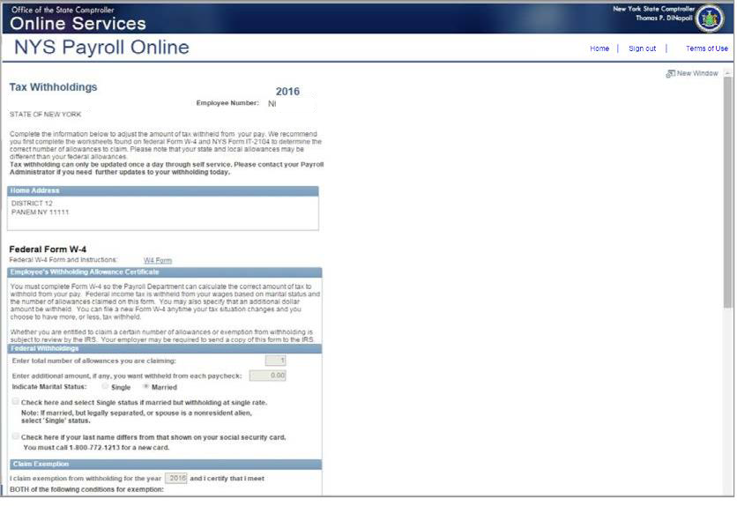
Updating Tax Withholding (continued)
From this page you can modify your federal, State, and local tax withholding information.

Slide 21
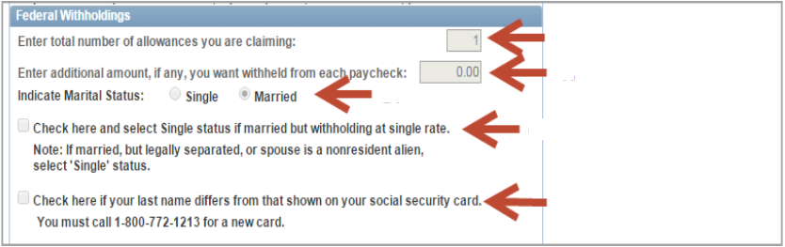
Updating Tax Withholding (continued)
Update Your Federal Withholding Change any applicable information.
Enter a new number of total Allowances
Enter an Additional Amount to be withheld.
Change your Marital Status
Check this box if married but withholding at a single rate. You must also indicate Single as your Marital
Status
Check this box if your last name does not match the last name on your Social Security card. You must call 1-800-772-1213 for a new card.

Slide 22
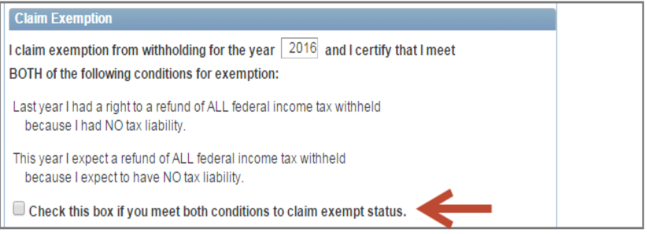
Updating Tax Withholding (continued)
Claim an Exemption from Federal Withholding
To claim exemption, you must meet the following conditions:
Last year you had a right to a refund of ALL federal income tax withheld because you had NO tax liability, and
This year you expect a refund of ALL federal income tax withheld because you expect to have NO tax
liability.
Check this check box to affirm that you meet both conditions and want to claim exempt status.

Slide 23
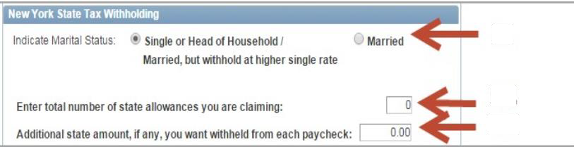
Updating Tax Withholding (continued)
Update Your New York State Tax Withholding
Change any applicable information
Change your Marital Status
Enter total number of State Allowances you want to claim.
Enter an Additional State Amount to be withheld.
NOTE: You cannot claim exemption from NYS tax withholding using NYS Payroll Online. To claim this exemption you must file Form IT-2104-E.

Slide 24


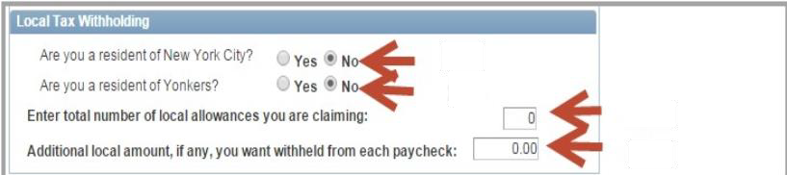
Updating Tax Withholding (continued)
Update Your Local Tax Withholding
Change any applicable information:
Indicate if you are a resident of New York City
Indicate if you are a resident of Yonkers
Enter total number of Local Allowances you want to claim.
Enter an Additional Local Amount to be withheld.

Slide 25


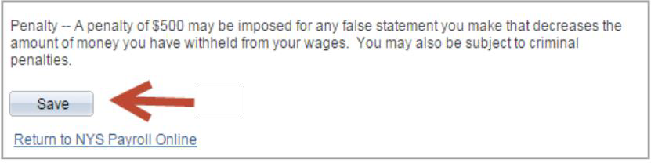
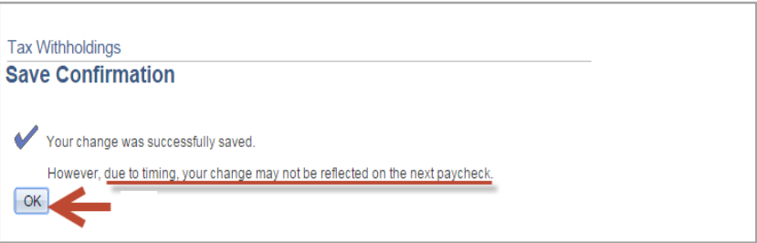
Updating Tax Withholding (continued)
Save All Changes
Click Save at the bottom of the page to save all changes to your tax information. NOTE: Penalty notification for false statements can be found above the Save button.
Click OK to return to the Tax Withholdings page.
NOTE: Due to timing, your changes may not be reflected in your next paycheck

Slide 26
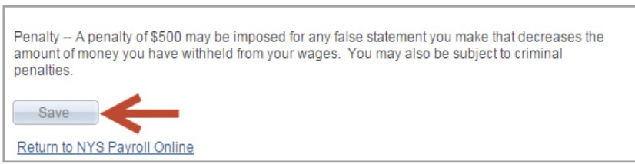
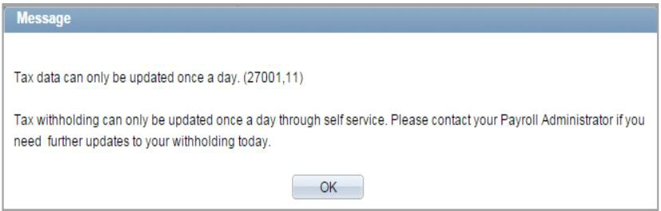
Updating Tax Withholding (continued)
NOTE: After returning to the Tax Withholdings page you will notice that the Save button has been grayed out. This is because you can only make changes to your tax withholding information once per day.
If you return to the Tax Withholdings page AFTER tax withholdings are modified and saved, you will immediately receive a message informing you that it can only be updated once per day.

Slide 27
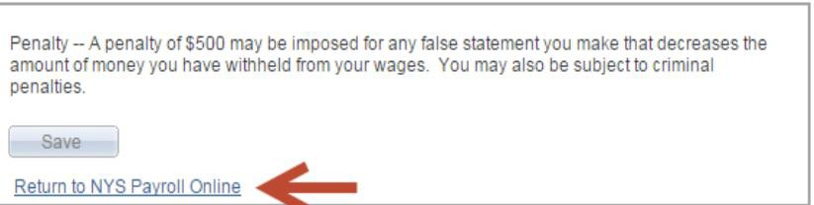
Updating Tax Withholding (continued)
Other Information on the Tax Withholdings Page
Link to the federal W-4 form and instructions.
Link to the NY State IT-2104 form and instructions.
Once changes are completed, Click Return to NYS Payroll Online to return to the NYS Payroll Online Home
page.

Slide 28


View, Print and Save W2
NYS Payroll Online makes it easy to view and print your W-2 form for the current year and
prior years. You will need Adobe Reader to view your W-2 in NYS Payroll Online.
Select View W-2 from the left menu.

Slide 29
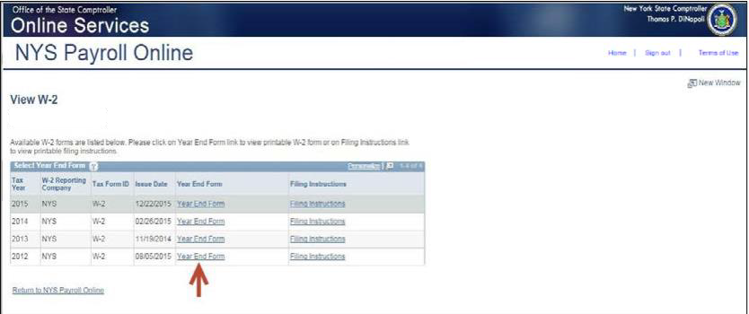
View W-2
The View W-2page displays the following items for each W-2 listed:
Tax Year
W-2 Reporting Company
Tax Form ID
Issue Date
Year End Form
Filing Instructions
Click Year End Form to view the W-2 for the selected year. Your W-2 will open as a PDF document in a new browser window. NOTES:
Please note that the View W-2 page currently shows only W-2 forms. Any amended W-2c forms (corrected W-2s) issued after the W-2 will not be included in this list.
If you are using Internet Explorer, a new browser window will open and ask you if you want to Open or Save your pay statement. Click Open and it will
open as an Adobe PDF document in a separate window.
Close the Adobe PDF window when finished viewing your W-2. Your W-2 will remain open until you close this window, even if you log out or are timed
out of NYS Payroll Online.
29

Slide 30
Print W-2
Print Your W-2 in Internet Explorer
Click File > Print and follow the prompts,
Move the mouse to the bottom of the window , select the Printer icon from the pop-up tool bar, and follow the prompts.
Print Your W-2 in Google Chrome
Click Menu > Print and follow the prompts
Select the Printer icon from the tool bar at the top of the window and follow the prompts.

Slide 31
Save W-2
Save Your W-2 in Internet Explorer
There are two available options:
Click File > Print and follow the prompts
Move the mouse to the bottom of the window, select the Diskette
icon from the pop-up tool bar, and follow the prompts.
Save Your W-2 in Google Chrome
There are two available options.
Right click, select Save as...and follow the prompts
Select the Download icon from the tool bar at the top of the window and follow the prompts.

Slide 32
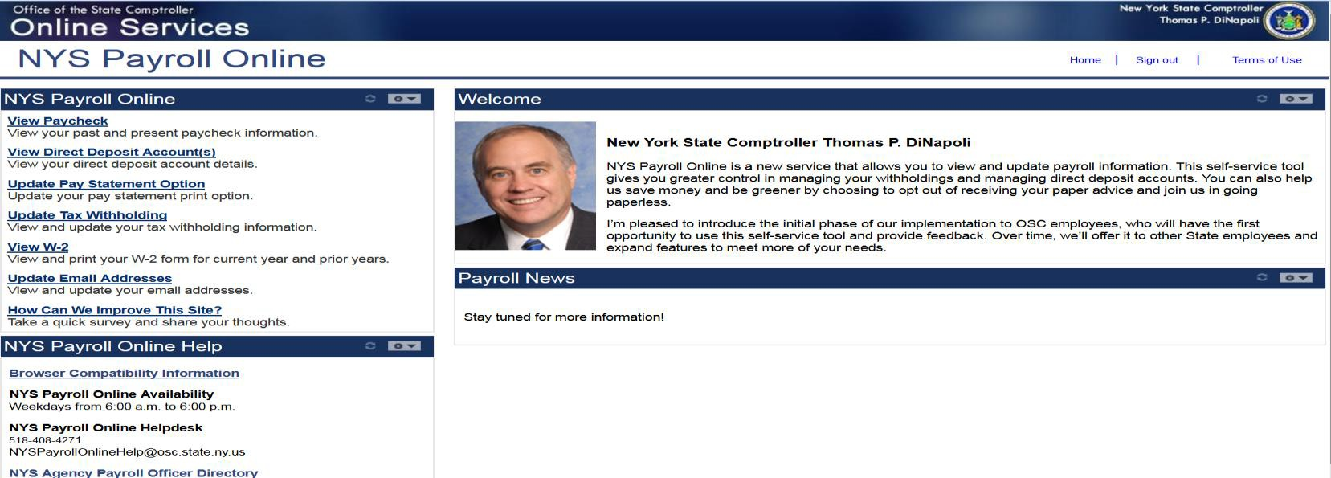


Updating Email Address
Each time you make a change to your information in NYS Payroll Online, an email will be sent notifying you of the change. This message will be sent to all of your email addresses stored in NYS Payroll Online. It is important that you maintain up-to-date contact information.
Select Update Email Addresses from the left menu.

Slide 33
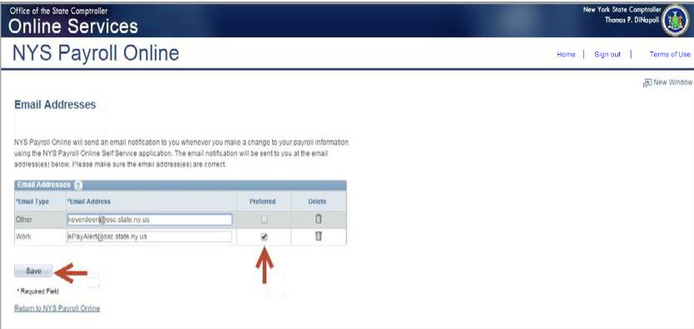
Email Address (continued)
From here you can change your preferred email address, update existing email addresses, add a new one
or delete an existing email address.
Preferred Email Address
Although you will be notified via email to BOTH email addresses each time a change is made, NYS Payroll Online requires that you have at least one email address in the system and designate a preferred email address.
To change your preferred address:
Click the check box under the Preferred column next to your preferred email
address.
Click Save to complete your change.

Slide 34
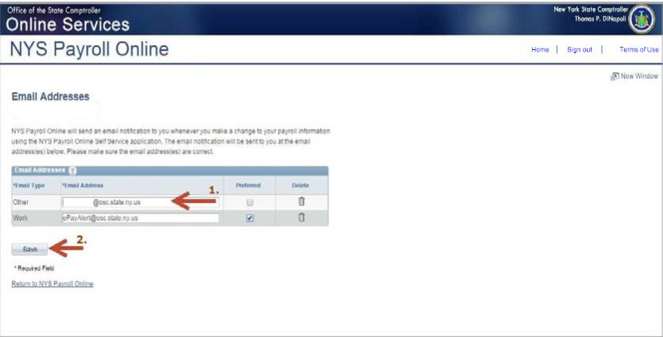
Email Address (continued)
Update Existing Email Address
Click in the Email Address field for the email address you want to update and enter your changes.
Click Save
Click OK to return to the Email Addresses page.

Slide 35


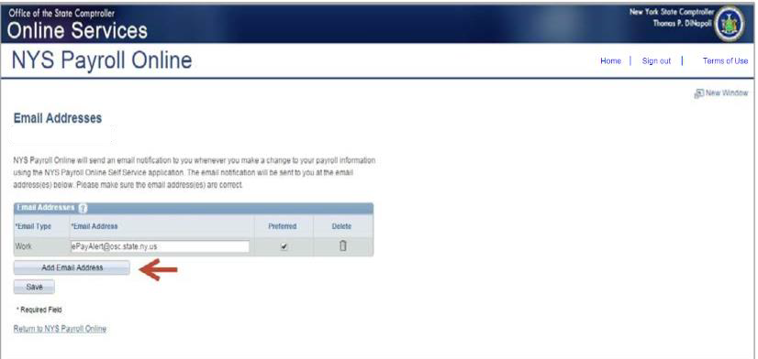
New Email Address
Add a New Email Address
Click Add Email Address to insert a new email address row.

Slide 36
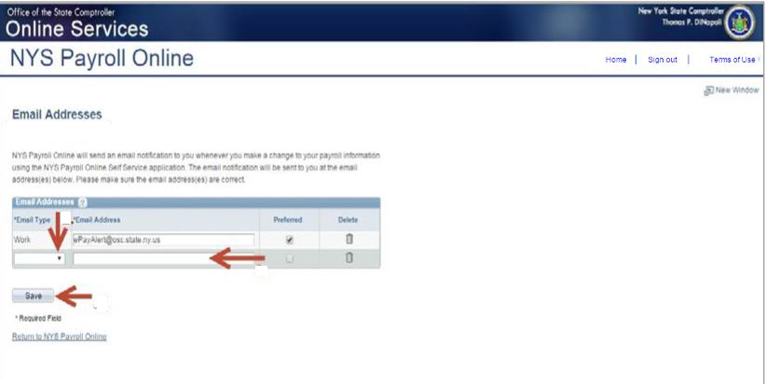
New Email Address (continued)
Select Work or Other from the Email Type drop down menu in the new row.
(What you see will vary based on what type of email address you already have in the system.)
Enter your new email address in the Email Address field in the new row.
Click Save

Slide 37

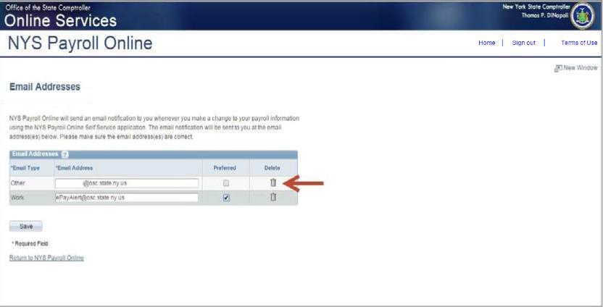
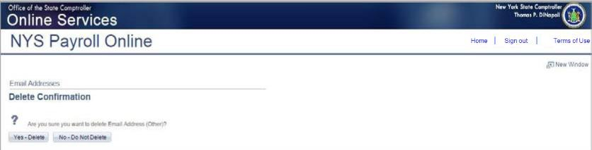
Deleting an Email Address
Delete an Email Address
Click the trash can icon next to the email address you want to delete.
NOTE: You will not be allowed to delete your preferred email address unless you change your preference for that address.
Select Yes – Delete to confirm deletion of this email address.

Slide 38

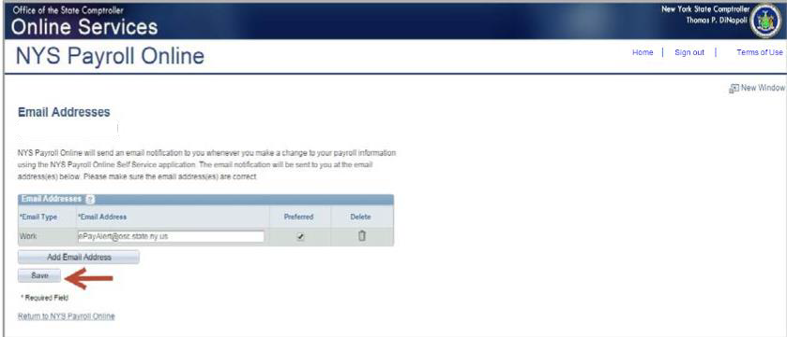
Deleting an Email Address (continued)
Click Save to complete your deletion. If you do not save this transaction the email address will continue
to be stored in NYS Payroll Online
Click OK to return to the Email Addresses page.

Slide 39
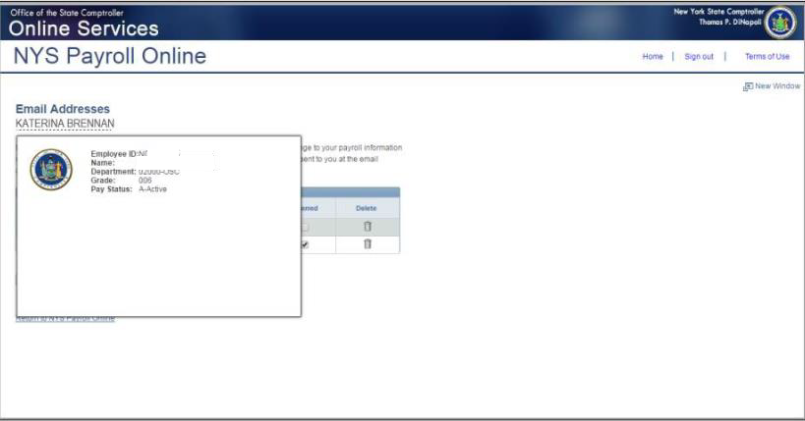
Personal Information
View Your Personal Information
Click on your name at the top of the screen under the Email Addresses header. A pop-up will be displayed showing your employee ID, your name, department, grade and pay status.

Slide 40
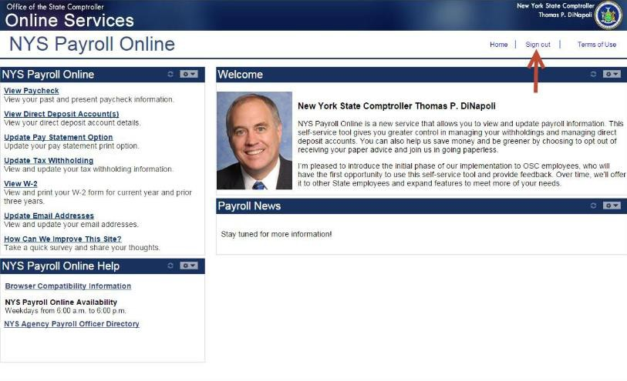
Sign Out
Sign Out
For security purposes, you should always Sign out of NYS Payroll Online when you are finished viewing
or updating your payroll information and close any other open browser windows.

Slide 41
Questions (?)
Please contact your campus Payroll Office with any questions.
Thank you!

