Slide 1
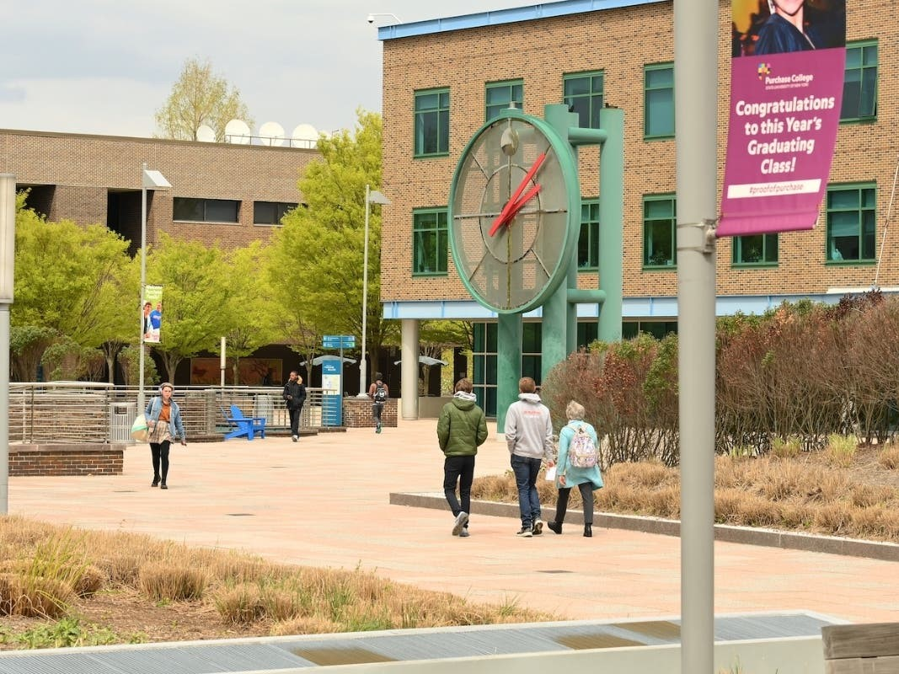


Mentee User Guide
Purchase Alumni
Mentor Network
provided by
The Career Development Center
&
The Office of Alumni Engagement

Slide 2

Why Join?
EFFORTLESSLY MENTORING PLATFORM
Get on demand career help from trusted Purchase College alumni and Broadview mentors that have firsthand experience.
Access personal coaching from professionals who’ve worked across different industries available for career conversations, portfolio reviews, interviewing tips, and many more topics to help you succeed during college and after graduation!
purchase.firsthand.co
Notes:
Expanding mentorship opportunities has never been easier with Vault. Our platform provides immediate and impactful networking opportunities that were once out of reach for many students. Our trusted matching algorithms recommend alumni from your institution who are willing to give back and offer mentorship. This feature allows students to connect with mentors who can provide personalized guidance, industry insights, and career advice, making the mentorship process seamless and highly beneficial for every student.

Slide 3

Register as a Mentee
Step 1:
Visit purchase.firsthand.co, click ‘Sign Up / Sign In’ and create your profile.
Step 2:
Sign up with email or our LinkedIn plug in and verify your new account!
Step 3:
View suggested mentor matches and request a consultation or view all mentors.
purchase.firsthand.co

Slide 4
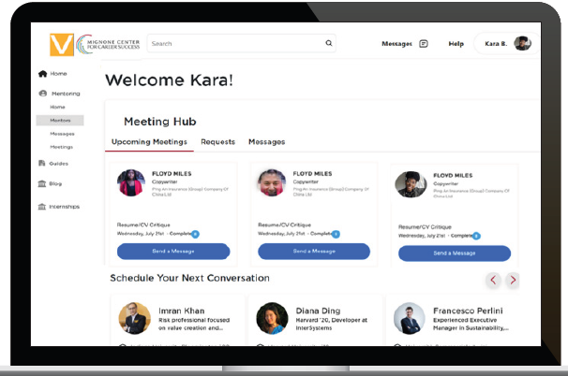
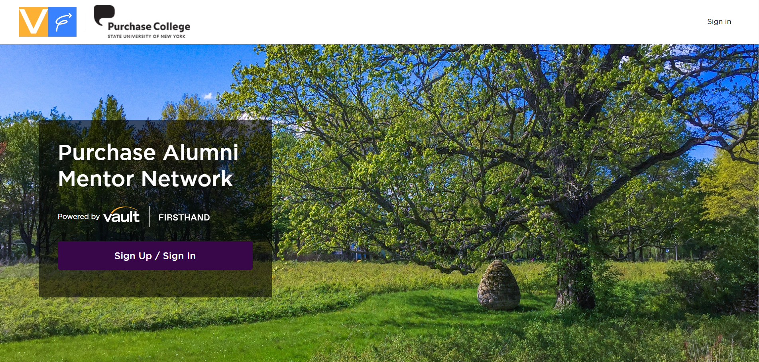
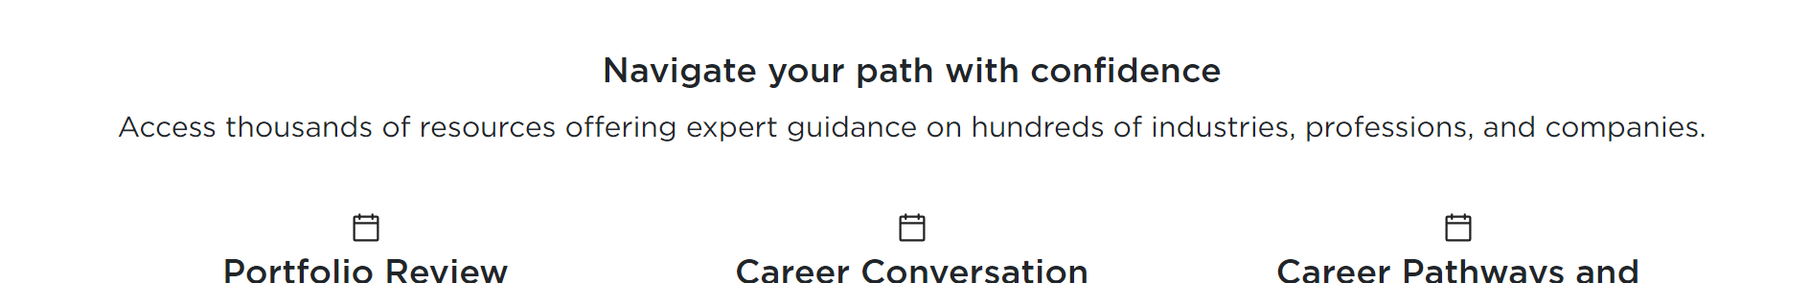
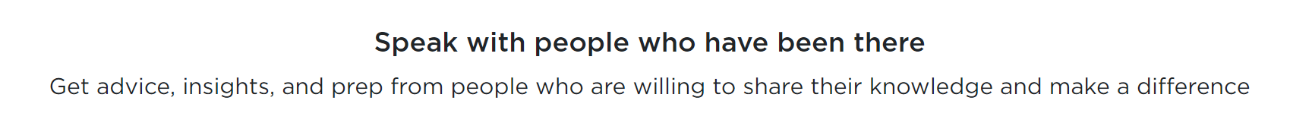
Find the Right Mentor
Browse Mentor Profiles
Find someone you’re interested in talking to. Filter mentors by function, industry, employer, type of consultation, location, field of study, language and more.
Learn About Mentors
Once you’ve found a mentor, click on their profile to learn more about them and book a consultation. Easily send off templated messages to connect.
purchase.firsthand.co

Slide 5
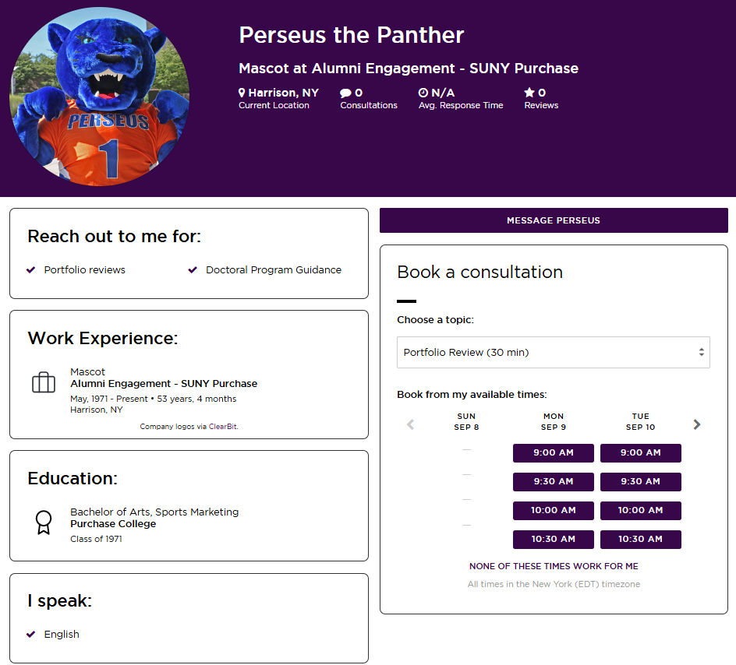
Book Your Consultation
Select a time to connect with a mentor under “Book a Consultation”
Suggest three meeting times and write a message introducing yourself and outlining what you’d like to get out of the consultation.
Submit your request and wait for the mentor to accept on of your suggested times.
purchase.firsthand.co

Slide 6

Connect With Mentor
CULTIVATE AUTHENTIC CONNECTIONS
Your ‘Meeting Hub’ on the homepage allows you to message your mentor and upload files in preparation for your session.
Use the provided web link provided to connect with your mentor at the schedule time.
Provide feedback on your consultation once completed.
purchase.firsthand.co

Slide 7
FAQ
How do I know if the mentor I select is right for me?
Before requesting a meeting, mentees can review the mentor's profile online, including any available feedback from other mentees. You can also view a mentor's current title, work experience, academic background and, when available, general schedule.
No, your phone number and email address are never shared with the mentor as all communication is routed through your consultation homepage.
Will the mentor be able to see my phone number or email address?
purchase.firsthand.co

Slide 8
Tips for a Successful Meeting
Before your consultation:
Write an introductory message and upload any documentation that will be relevant to your call (e.g. resume, cover letter, job description, etc.)
Respect the mentor's time commitment by planning and preparing topics of discussion. Prepare specific, intelligent, and productive questions that can guide your discussion.
During your consultation:
Be prepared to briefly introduce yourself professionally.
Prior to your session think about your purpose for talking with a particular mentor. Would you like to learn more about the invention, patent filing, research etc.?
Remember to keep the conversation professional. Do not ask personal questions or ask a mentor directly for job placement or internship assistance.
Strive to be a receptive and active listener
After your consultation:
Show appreciation for the time and assistance given by the mentor by sending a follow up thank-you message. Note that unless the mentor provides his/her contact information during the call, you must do this within 24 hours of the consultation, while your consultation homepage is still active
purchase.firsthand.co

Slide 9

Sign Up Today!
WANT MORE INFORMATION?
You can reach out to career.development@purchase.edu and support@firsthand.co
for any questions or concerns.
Contact VaultCampus@Vault.com

