Slide 1
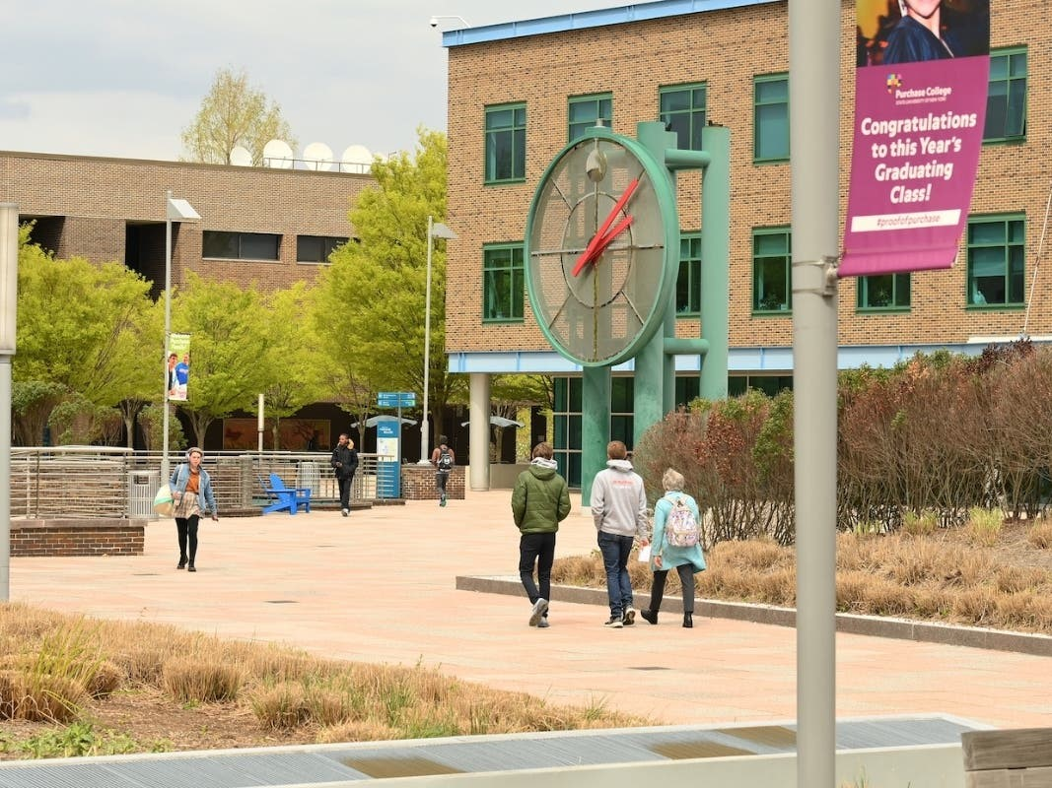


Mentor User Guide
Purchase Alumni
Mentor Network
provided by
The Office of Alumni Engagement
&
The Career Development Center

Slide 2

Why Give Back?
THE FUTURE LEADERS ARE ASKING FOR YOUR HELP!
Give back in an impactful way – offer your time and talent to help Purchase College students and recent alumni get their start with career exploration and the job search
Easily, on your own time – give back whenever and how often you want, on topics you know well
With your privacy protected – we don’t share your contact info
purchase.firsthand.co
Notes:
Expanding mentorship opportunities has never been easier with Vault. Our platform provides immediate and impactful networking opportunities that were once out of reach for many students. Our trusted matching algorithms recommend alumni from your institution who are willing to give back and offer mentorship. This feature allows students to connect with mentors who can provide personalized guidance, industry insights, and career advice, making the mentorship process seamless and highly beneficial for every student.

Slide 3
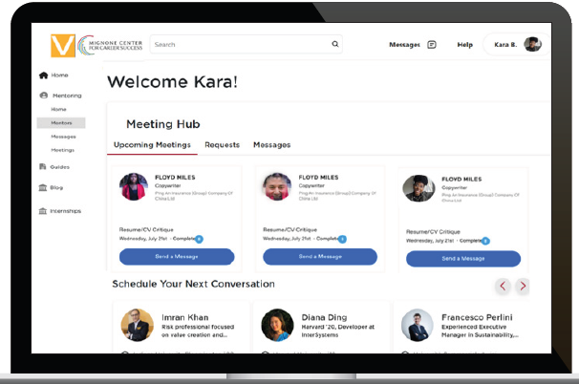
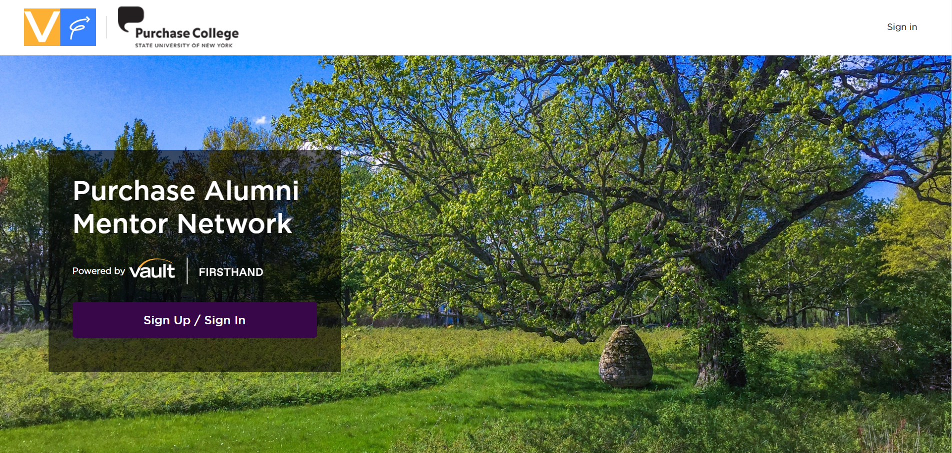
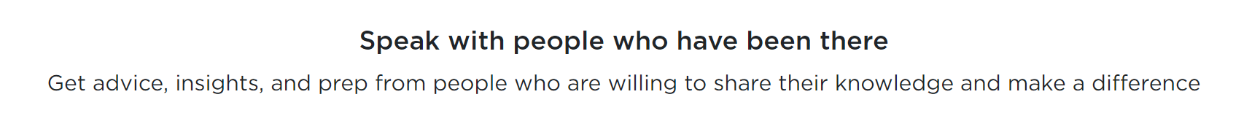
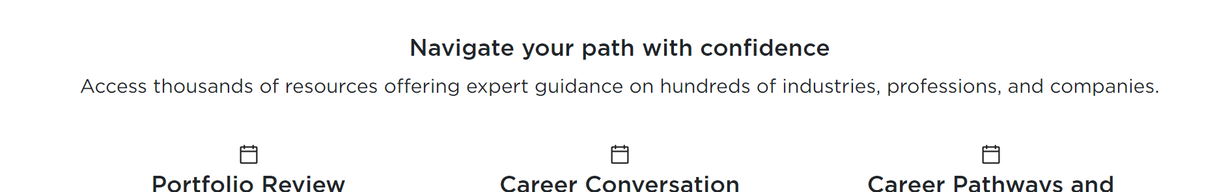
Register as a Mentor
Step 1:
Visit purchase.firsthand.co, click ‘Sign Up / Sign In’ and follow the quick steps to authenticate.
Step 2:
Create your profile within minutes by registering with your email or through our LinkedIn plug in and specifying the types of advice you’d like to offer. You can sign in at any time to view and make changes to your account.
purchase.firsthand.co

Slide 4

Connect with Mentees
Get Connected
When you get a consultation request, you will receive an email notification from the platform.
Accept, decline or suggest new times to meet for the mentee to choose from. It is important to respond to the meeting request within a day or two to avoid your account being flagged as an unresponsive mentor in the system.
Your consultation homepage allows you to communicate with the mentee and share files.
When your meeting is confirmed, you will be sent a conference link to join– your mentee will also receive similar messaging so they can join at your scheduled time.
purchase.firsthand.co

Slide 5
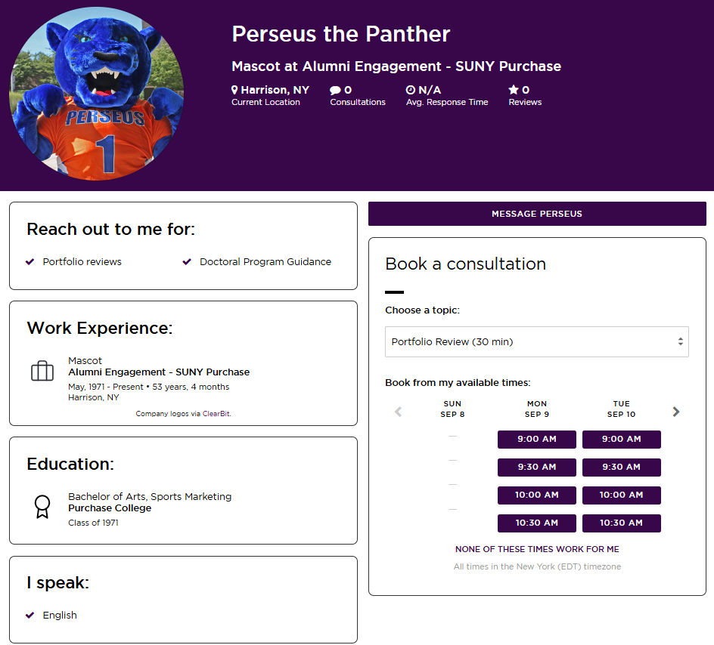
Manage Your Profile
CULTIVATE AUTHENTIC CONNECTIONS
When you’re logged into your account, you will be able to make changes to your profile, set out of office hours, edit your availability and view and manage past and current consultations.
purchase.firsthand.co

Slide 6
FAQ
What types of advice can I offer?
You are welcome to provide any career-related advice that you think is relevant to your mentee. Whether they are interviewing for a job or internship or learning about a specific industry, mentees want your unique perspective. Mentees are responsible for outlining what type of information they are seeking. Feel free to ask your mentee for additional clarification in advance of the conversation.
Will the mentee be able to see my phone number or email?
No, your phone number and email address are never shared with the mentee as all communication is routed through your consultation homepage.
Where on my profile can I outline how I can be most helpful to mentees?
We recommend filling out your headline and ‘About Me’ section to give mentees a better idea of what you can offer. Generally, the more details the better.
purchase.firsthand.co

Slide 7
Tips for a Successful Meeting
Meeting Requests:
You will receive an email that will have some suggested meeting times and will also include details about the type of advice the mentee is looking for (e.g., informational interview for internship). Once you accept the meeting request for a specific time, you will receive a calendar invitation.
Preparing for Your Meeting:
We recommend you prepare as you would for any professional meeting. You can contact your student in advance of the meeting through the consultation homepage (accessible on your mentor profile) if you have specific questions on what they would like to cover (e.g., types of investment banking interviews they want to focus on) or if you want them to forward additional files to your attention. All information will be shared through this consultation page and we will notify you by email if the student contacts you.
purchase.firsthand.co

Slide 8
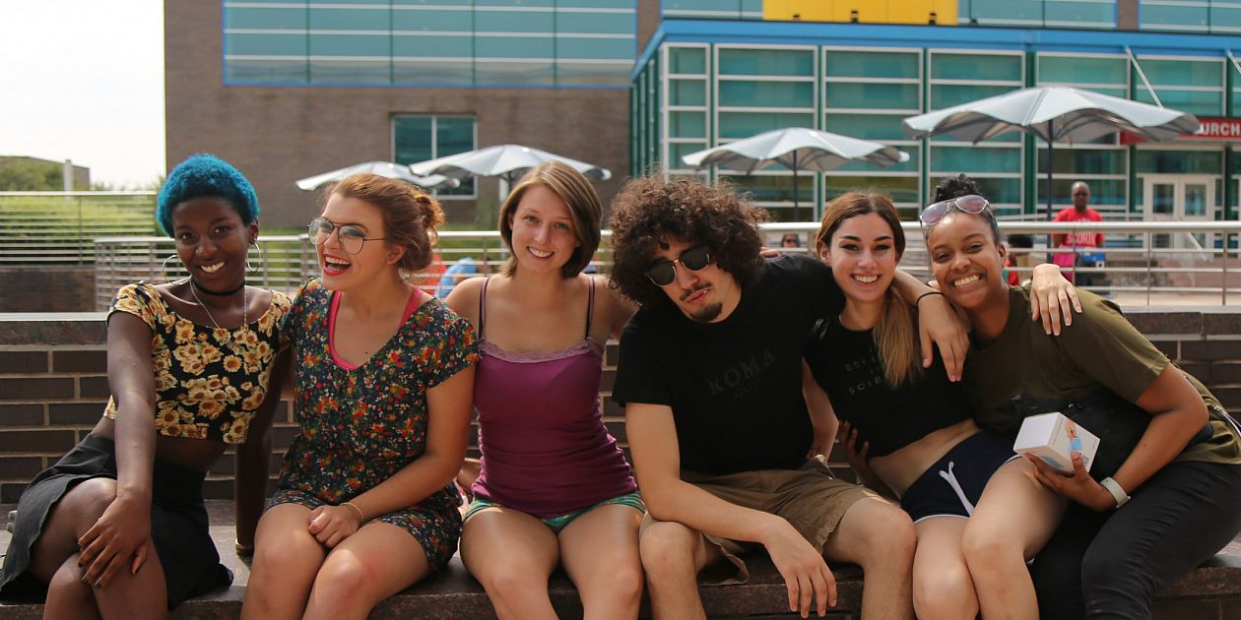
Give Back Today!
WANT MORE INFORMATION?
You can reach out to alumni@purchase.edu and support@firsthand.co
for any questions or concerns.
Contact VaultCampus@Vault.com

